Slide 1
CS 4530: Fundamentals of Software Engineering Module 13: Continuous Development
Adeel Bhutta, Joydeep Mitra and Mitch Wand
Khoury College of Computer Sciences
© 2025 Released under the CC BY-SA license

Slide 2
Learning objectives for this lesson
By the end of this lesson, you should be able to…
Describe how continuous integration helps to catch errors sooner in the software lifecycle
Describe strategies for performing quality-assurance on software as and after it is delivered
Understand how continuous delivery can work with or without TDD (test driven development) as a quality assurance strategy

Slide 3
Review: The Agile Model Reduces Risk by Embracing Change (~2000)
The Waterfall philosophy:
"The project is too large and complex, and it will take months (or years!) to plan, so once we come up with the plan, that plan can not change"
Reduce risk by proceeding in stages
The Agile philosophy:
The project is too large and complex, it is unlikely that we will know exactly what we need right now, and to some extent, we are inventing something new. We think that as we make it, we will figure it out as we go”
Reduce risk by limiting time on any one stage; then reassess. (“time-boxing”)
Reduce risk through automated testing
Notes:
To talk about continuous integration and continuous delivery, it is helpful to recall the motivation for the agile software development movement, and what they were trying to achieve (read slide)
Really the key part is that Agile offers the following promise: what if we could build software in such a way that we could embrace both defects and change. If you build a process that can have an “agile” response to shifting requirements, you are also probably building one that can tolerate defects much better.
Compare to waterfall philosophy on risk:
Waterfall says: "The project is too large and complex, and it will take months (or years!) to plan, so once we come up with the plan, that plan can not change"
agile says “The project is too large and complex, it is unlikely that we will know exactly what we need right now, and to some extent, we are inventing something new. We think that as we make it, we will figure it out as we go”

Slide 4
Agile relies on a variety of quality-assurance processes
What are the costs & benefits of each of these?
unit testing/TDD
code review
integration tests (as in module 12)
continuous integration
continuous deployment (A/B, canaries, etc.)
How is each automatable?
How does each address non-functional quality attributes?
How should these be combined in an organization's software development process?

Slide 5
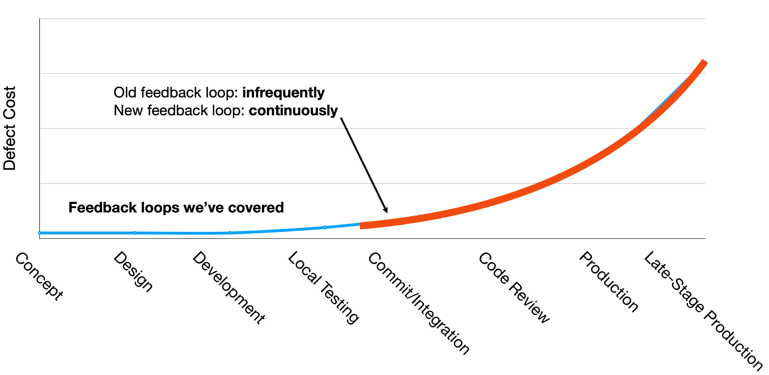
In this module, we'll focus on CI/CD
What are the costs & benefits of each of these?
unit testing/TDD
code review
integration tests (as in module 12)
continuous integration
continuous deployment (A/B, canaries, etc.)
How is each automatable?
How does each address non-functional quality attributes?
How should these be combined in an organization's software development process?
Notes:
Continuous Integration and Continuous Delivery focus on the red portion of the infamous cost-to-repair diagram.

Slide 6
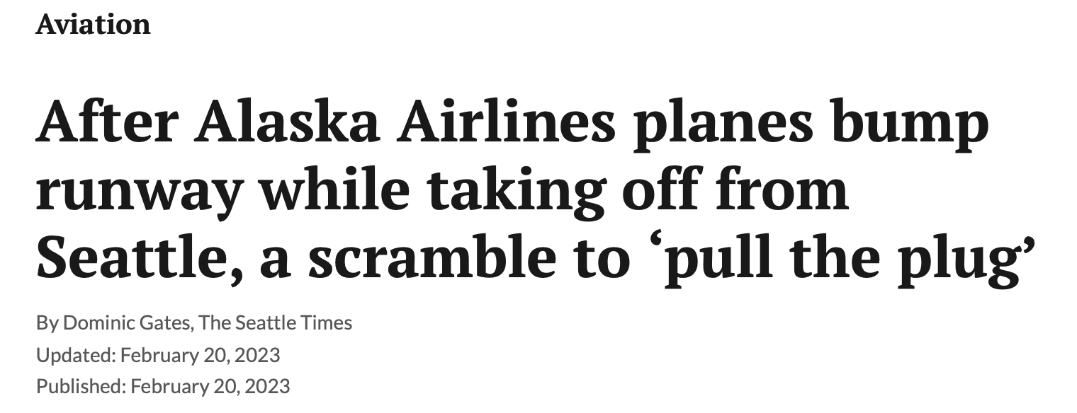

Example: Some bugs slip through testing, even in highly-regulated industries
… “A quick interim fix proved easy: When operations staff turned off the automatic uplink of the data to the aircraft and switched to manual requests “we didn’t have the bug anymore.”
Peyton said his team also checked the integrity of the calculation itself before lifting the stoppage. All that was accomplished in 20 minutes.
The software code was permanently repaired about five hours later.
Peyton added that even though the update to the DynamicSource software had been tested over an extended period, the bug was missed because it only presented when many aircraft at the same time were using the system.
Subsequently, a test of the software under high demand was developed.”
“That morning, a software bug in an update to the DynamicSource tool caused it to provide seriously undervalued weights for the airplanes.
The Alaska 737 captain said the data was on the order of 20,000 to 30,000 pounds light. With the total weight of those jets at 150,000 to 170,000 pounds, the error was enough to skew the engine thrust and speed settings.
Both planes headed down the runway with less power and at lower speed than they should have. And with the jets judged lighter than they actually were, the pilots rotated too early Both the Max 9 and 737-900ER have long passenger cabins, which makes them more vulnerable to a tail strike when the nose comes up too soon.” …
Photo: saiters_photography (IG, different plane/airpot)
https://www.adn.com/alaska-news/aviation/2023/02/20/after-alaska-airlines-planes-bump-runway-a-scramble-to-pull-the-plug/
Notes:
The unfortunate reality with TDD is that, even if you practice it quite carefully, some bugs will only present themselves in circumstances that you failed to predict. Consider this example from Feb 2023 – in the *aviation software* domain – one that is notorious for having regulatory requirements around requirements validation and software testing practices.
What happened? Within 10 minutes, TWO Alaska 737’s had tail strikes upon takeoff – the photo shows what a tail strike is. A tail strike is when the back of the tail of the plane scrapes along the ground during takeoff. The plane is still flyable, can land, and is not totaled – but need an expensive repair before future flight.
After the second strike, this was clearly noticed by the dispatchers who were literally watching it happen from the tower. In response, the dispatchers “pulled the plug” – halted all takeoffs of any of the airline’s planes for 22 minutes.
They quickly found that the problem was due to a bug introduced that morning in software used for calculating how much power the pilot should apply to the engines at takeoff. Too much wastes fuel, too little can result in a tail strike (or a completely failed takeoff). They were, luckily, not THAT far off in weight calculation - if it were MORE wrong, they could have failed to take off + overrun the runway, or gotten airborne but failed to clear obstacles
The vendor found the bug in the load calculation tool and deployed a fix.
The lessons that *we* draw from this story are:
1. Writing thorough test suites is hard
2. If you are going to deploy an update, your sure as *** better have some process for monitoring that update and reverting as necessary
Additional commentary: FWIW, maybe it’s just easy to find software flaws with Boeing 737’s (although this one didn’t just effect the Max 900 that is most notorious, also the 900ER)…

Slide 7
CI/CD practices improve code quality and dev velocity
Continuous integration: use automated systems to perform and monitor frequent integrations with entire codebase, running integration-scale tests
Continuous delivery: use automated systems to perform frequent, controlled delivery of product (often to a small fraction of the user base), with automated monitoring to detect remaining defects quickly.
Notes:
Continuous development aims to help us achieve better code quality (fewer bugs, or at least reduce their impact) and development velocity (get features out to customers faster) by creating frequent, fast feedback loops at each stage of the development process. Continuous development encourages us to perform frequent integrations, merging changes into our entire codebase, and running integration-scale tests frequently. Key to continuous development is frequent integration and deployment of our product
Continuous development represents a process like agile, but distinguished by frequent feedback, which aims to help us to “shift left”. Whereas in a traditional development process, we might integrate all of our changes and perform end-to-end tests (and deployments) on a weekly or monthly basis, continuous development argues for faster feedback loops: integrate your code hourly and deploy multiple times a day.

Slide 8
13.1: Continuous Integration

Slide 9
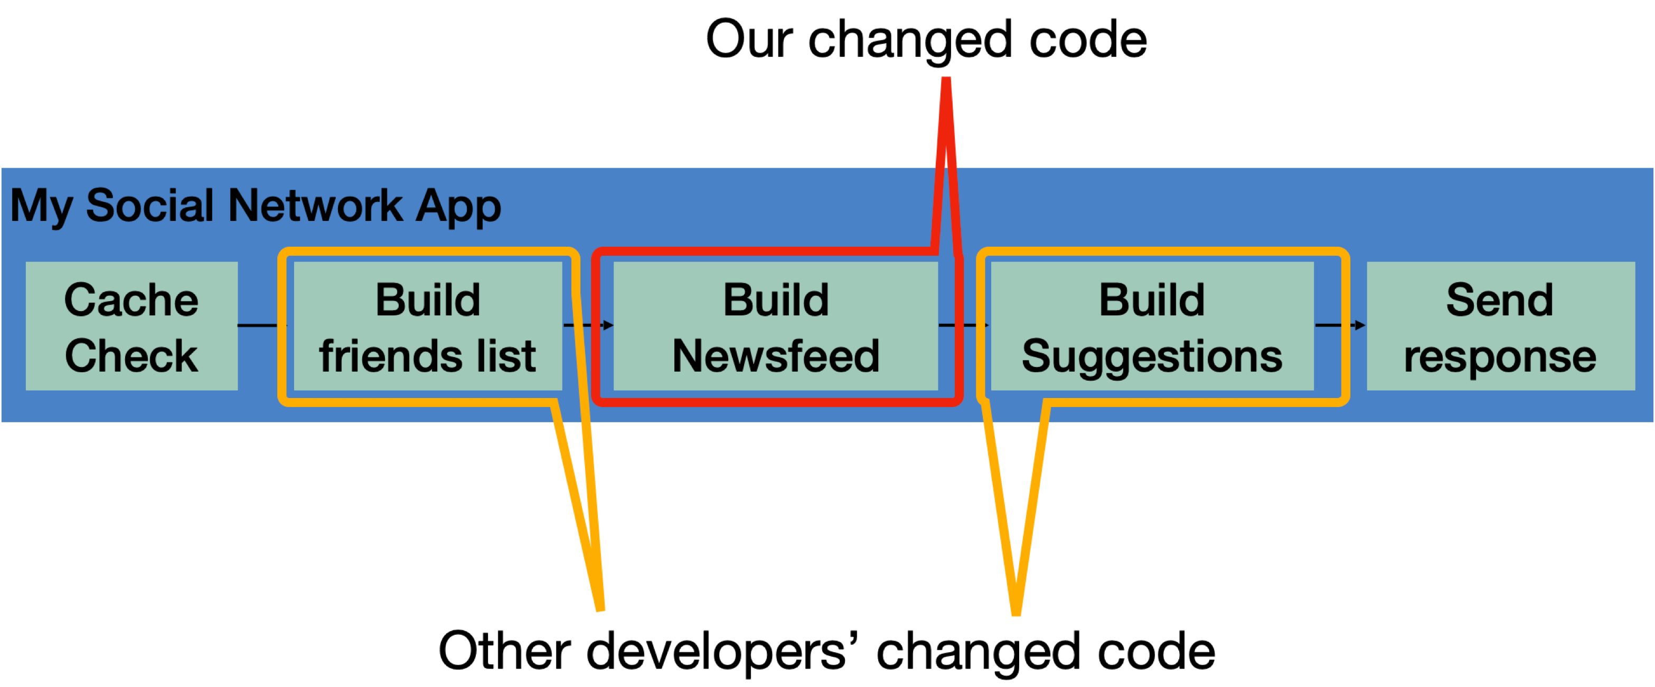
Continuous Integration (CI) provides global feedback on local changes
Given: Our systems involve many components, some of which might even be in different version control repositories
Consider: How does a developer get feedback on their (local) change?
Notes:
Continuous integration is particularly relevant in software that involves multiple components. A developer might change code in one component, say, the code that handles building the newsfeed that will show up in the returned page. This might live in one repo, and be an independent component. However, this component is part of a bigger, overall application, which consists of other components: the newsfeed probably depends on other components (like that which builds a friends list), and there might be other components that depend on the newsfeed (like something that builds a list of suggestions). There might be even more complex interactions with other components: like perhaps before sending a response back to a client, the server will save the response into a cache, and on repeated requests, that cache is served. There might be other changes going on, too - other developers are likely working on changing other components at the same time. Traditional waterfall or even agile development processes often involve performing integrations between all of these changes infrequently - perhaps weekly or monthly. The idea behind continuous integration is to integrate these changes and test them rapidly - as soon as they are created.

Slide 10
A CI process is a software pipeline
Automate this centrally, provide a central record of results
Develop
Build
Test
Deploy
Monitor
Code Review
Style Check
Integration Test
End-to-end Test
KPIs
0…………….
Compile
Load Test
Unit Test
Prepare Deployment
Notes:
So, the core to continuous integration is to centrally and automatically execute these development processes, regularly.
With CI, we continuously assemble and test changes to our codebase. By performing these integrations quickly and frequently, we can get faster feedback, and hence, “shift left” - allowing bugs to be detected sooner. There’s an enormous difference in how long it takes to debug something if you detect the bug immediately after writing the code versus even, say, the next day - let alone after several weeks.
CI processes are software pipelines. “Pipeline” systems are good for building systems that have a specific order of operations, with dependencies between some steps. CI workflows follow this pattern: some steps depend on others (can’t test until you build), but many steps might be possible in parallel (run many different kinds of tests concurrently)
Consider our “social network application”, where we are changing code that builds a newsfeed, and other developers are changing other parts of the code? What concrete steps do you think that we should include in the build/test CI? Keep in mind that these might be things that you would otherwise do manually, but now have decided to automate.
<Examples, in case they don’t come up: Run unit tests, run integration tests, run international localization tests, validate that it still works with some infrastructure deployment, do regression testing, accessibility testing, check/gate on various quality metrics like coverage, security audit, code review>

Slide 11

CI may be triggered by commits, pull requests, or other actions
Example: Small scale CI, with a service like CircleCI, GitHub Actions or TravisCI
GitHub
commits code to
checks for updates
Developer
GitHub Actions
TravisCI
CircleCI
Runs build for each commit
Notes:
Run an entire test suite on each commit, or perhaps do other things. Each commit triggers some workflow to run, and we can customize that workflow to do anything from building our code, to running tests, to deploying infrastructure.

Slide 12
Automating Feedback Loops is Powerful
Consider tasks that are done by dozens of developers (e.g. testing/deployment)
© Randal Munroe/xkcd, licensed CC-BY-SA
https://xkcd.com/1205/
Notes:
This XKCD comic does a nice job visually summarizing the value of automating feedback loops. It is a table that shows how much time you would save over a 5 year period if you automated a task (with the Y axis showing how long the task takes otherwise and the X axis showing how often you do the task). There are, for sure, some tasks that are unlikely to be worth automating – those that are very fast to do and that you do infrequently.
However, there are also some tasks that you clearly should automate: if there is something that takes you 30 minutes to do every day, you will save 5 weeks of time over a 5 year period if you could automate it.
Something that this table *doesn’t* take into account is that you might want to do that task MORE OFTEN than you do, but doing it manually just costs too much. For example: maybe running some test suite takes 30 minutes, and so you only do it once a week. If you COULD run it without taking you away from another task – perhaps you would run it more frequently?
<Ask students for examples of tasks that they have decided to automate on different projects/life/etc>
<Note that there are a lot of hidden man-hours into maintaining automation, and the cost of monitoring>

Slide 13
Typical CI pipeline
Set up testing environment
Set up tests
Set up multiple input
Run all tests against all inputs
(preferably in parallel)
Record results and performance in central db
Big Data (lots of work)
Partition
Stage 1
Stage 1
Stage 1
Stage 1
Stage 1
Stage 2
Stage 2
Stage 2
Stage 2
Stage 2
Stage 3
Stage 3
Stage 3
Stage 3
Stage 3
Combine
Result
Notes:
This would be hard to do reliably by hand, so we set it all up with scripts of various sorts
Tools like github or travis CI provide tools to write the necessary scripts and run them.

Slide 14
You could set up multiple CI processes
Run a short test daily
or oftener
maybe on every commit?
More comprehensive test less often
provides more accurate performance data
Either way, you know that your integration is working!

Slide 15
Continuous Integration is Highly Configurable
Determining how to apply CI can be non-trivial for a larger project, all with a cost vs quality tradeoff: what is the cost of automation vs the value of developer time?
Do we integrate changes immediately, or do a pre-commit test?
Which tests do we run when we integrate?
When do we integrate code review?
How do we compose the system under test at each point?
Changed code
My Social Network App
Cache Check
Build friends list
Build Newsfeed
Build Suggestions
Send response
Other developers’ changed code
Notes:
Immediately/pre-commit: small project with a few commits a day and a test suite under 30 mins, probably integrate immediately and run full test suite. But: consider our social network app, where we might have 20 changes/hour and a 30 mins test suite, when do you choose to integrate things? Do we wait for last integrated change to pass before integrating next?
Which tests to run - again, easy on small. But: what if our big social network app: we probably should also run tests that could depend on this (like other components of our request pipeline). At the limit: maybe now our new newsfeed change will impact how the request caching feature works, and we should check that too. Do we check everything?
How do we compose system under test - do we use mocks for external services, or do we use production, or do we make a special environment for each integration test?

Slide 16
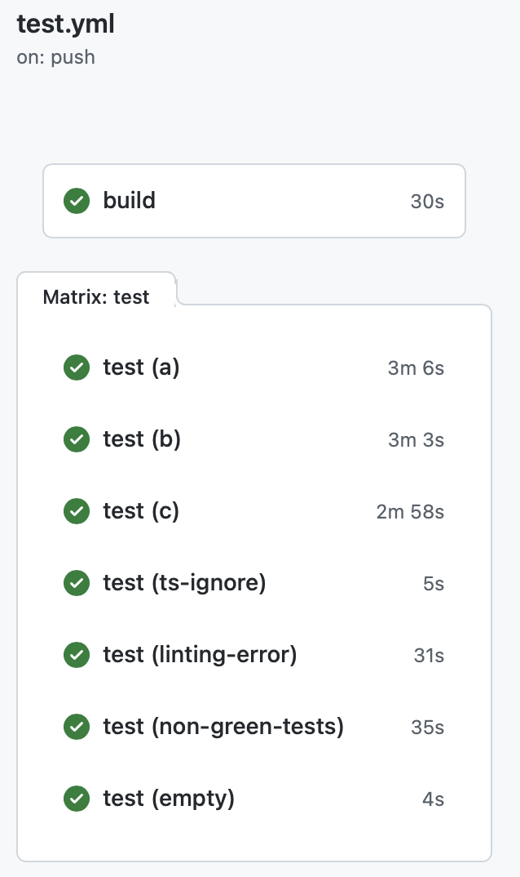
CI In Practice: Autograder
GitHub Actions Results
test.yml (CI workflow file)
name: 'Build and Test the Grader'
on: # rebuild any PRs and main branch changes
pull_request:
push:
branches:
- main
- 'releases/*'
jobs:
build:
runs-on: self-hosted
steps:
- uses: actions/checkout@v2
- uses: actions/setup-node@v2
with:
node-version: '16'
- run: |
npm install
test:
runs-on: self-hosted
strategy:
matrix:
submission: [a, b, c, ts-ignore, linting-error, non-green-tests, empty]
steps:
- uses: actions/checkout@v2
- uses: actions/setup-node@v2
with:
node-version: '16'
- uses: ./
with:
submission-directory: solutions/${{ matrix.submission }}
Notes:
By “Test”, we don’t just mean running Jest tests. A CI workflow consists of a set of “jobs”, which are simply scripts, in this case, written in a mix of Bash and TypeScript.
Here is a workflow that we use to test changes in the autograder (our IP2 autograder, unfortunately the IP1 autograder was using a different sytem!) – the grader is automatically executed in a clean environment on various representative submissions
On the left, we can see the workflow that is run every time that we push a commit to the repository that hosts the IP autograder.
This workflow is triggered on any pull request on the repo, or on any push to the branch “main” or a branch that is prefixed with “releases/”.
There are two kinds of jobs: build, and test. Both run on our self-hosted github actions environment (runs-on), but there could be other values here to specify, say, an OS version to use.
The steps to build the project are to: 1. Check out the project, 2. setup nodeJS version 16, and 3. install it. If any of these steps fail, then the job fails, and we would see a red X in our build result.
Then, there is a job “test”, which in this case we allow to start running immediately (no dependency on build). The test job is parametrized over an array called “submissions”, which defines various example test suites that we test the autograder on with every commit (in GitHub Actions terminology, this is called a ‘build matrix strategy’). The test step also checks out the code, and also sets up NodeJS, and then it runs the autograder. The autograder is implemented in TypeScript as a GitHub Action itself, so we invoke it by telling GitHub to use the action defined in this repository (./), passing the spectiic submission directory that should be used to execute the autograder.
This workflow allows us to get very fast feedback on changes to the grading scripts – the grader is automatically executed in a clean environment on various representative submissions, and it can all happen in parallel.

Slide 17
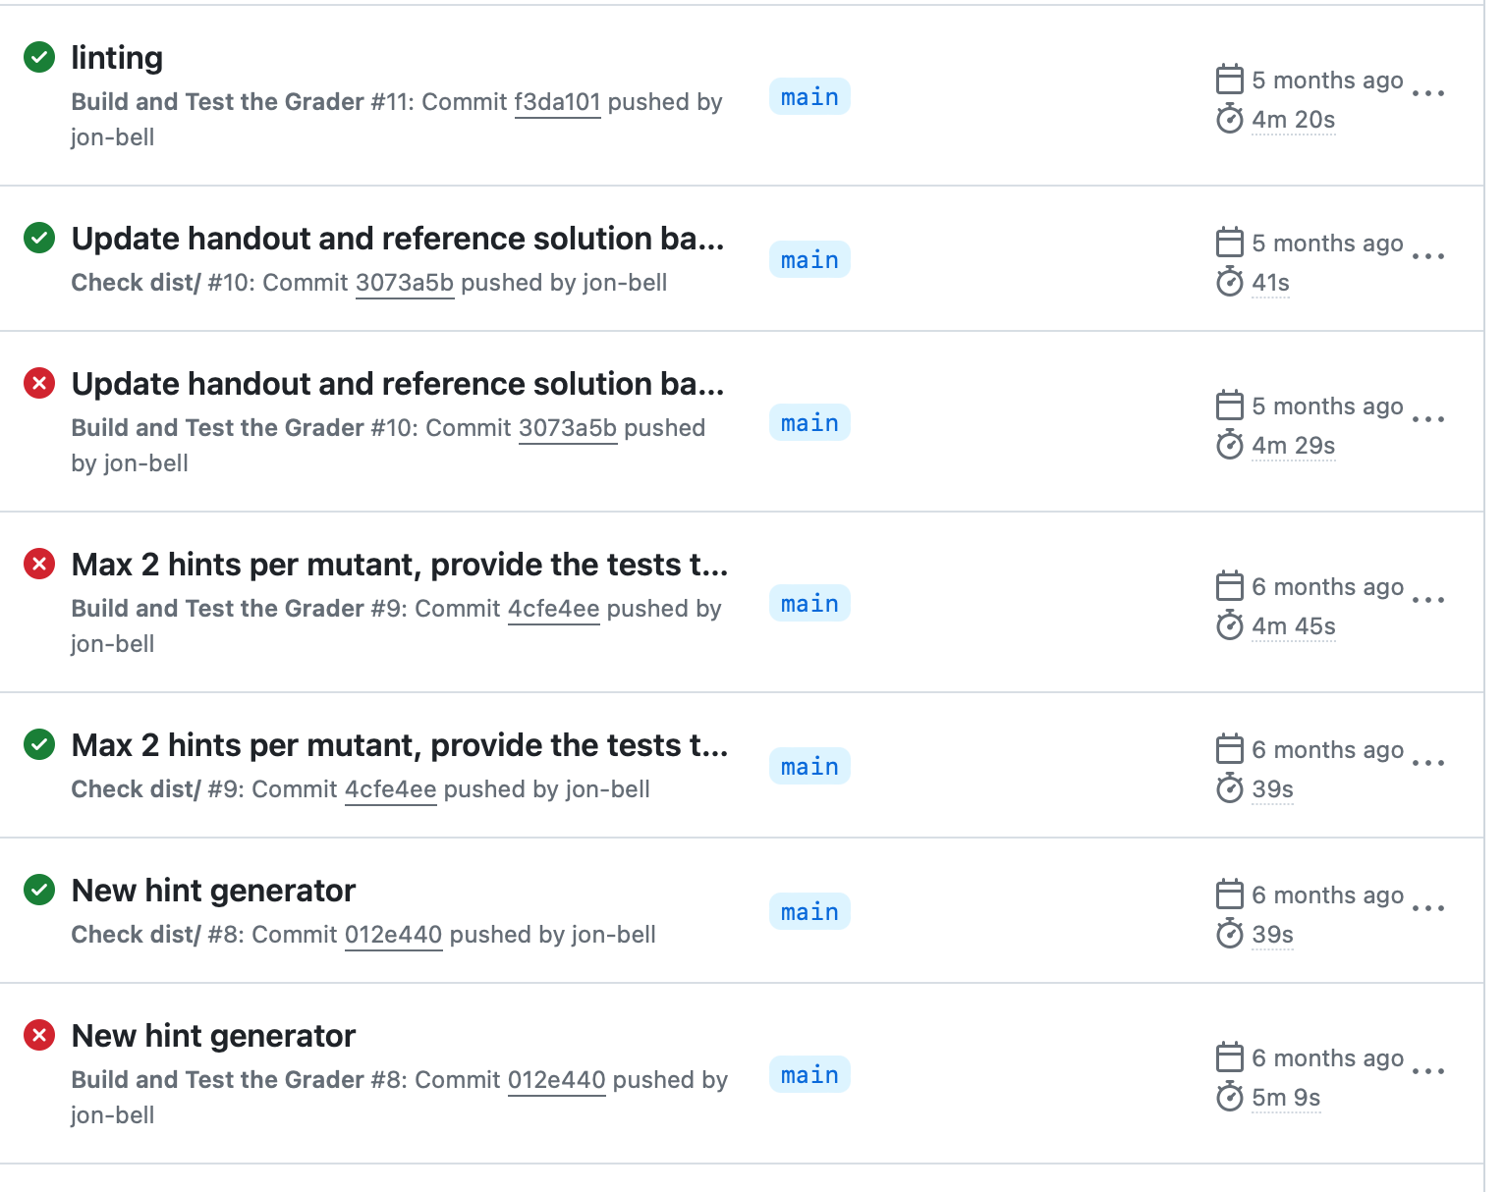
Example CI Pipeline - Autograder
At a glance, see history of build
Notes:
Here’s another view of that same project’s CI pipeline: here we can see the history of each build. From this view, any developer can answer the simple question: “when did a test break? What fixed it?”

Slide 18
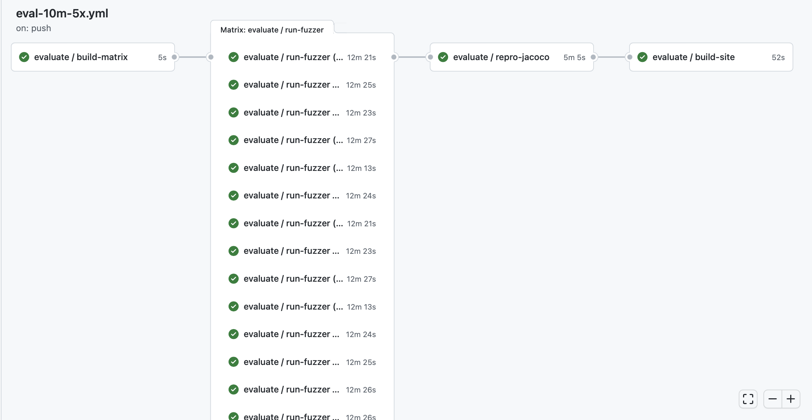
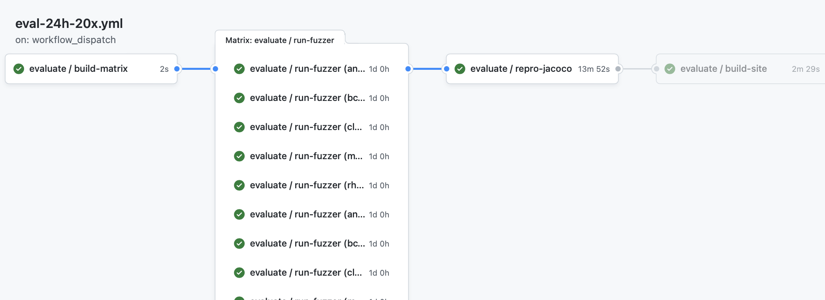
CI pipelines can automate performance testing
Every commit: Run 10 minute performance test on 5 benchmarks, repeating each test 5 times (25 concurrent jobs)
On Demand: Run 24 hour performance test on 5 benchmarks, repeating each test 20 times (100 concurrent jobs)
https://github.com/neu-se/CONFETTI/actions
Notes:
These screenshots show the graphical summary of two CI pipelines set up for a software testing research tool.
The top one shows a workflow that can run on every commit, providing useful feedback on performance and correctness in about 15 minutes: running a 10 minute performance test on 5 benchmarks, repeating each one 5 times (25 concurrent jobs needed)
The bottom one shows a workflow that runs only upon request, which performs a much more thorough evaluation: 20 repetitions of 5 benchmarks, with each running for 24 hours.
In both cases, there are 4 jobs defined: 1. build the matrix (run a script that will determine which benchmarks to run), 2. (in parallel) run the fuzzer on those benchmarks, 3. collect all of those results and reproduce them for later analysis, and 4. render a report into markdown and HTML that summarizes the results

Slide 19
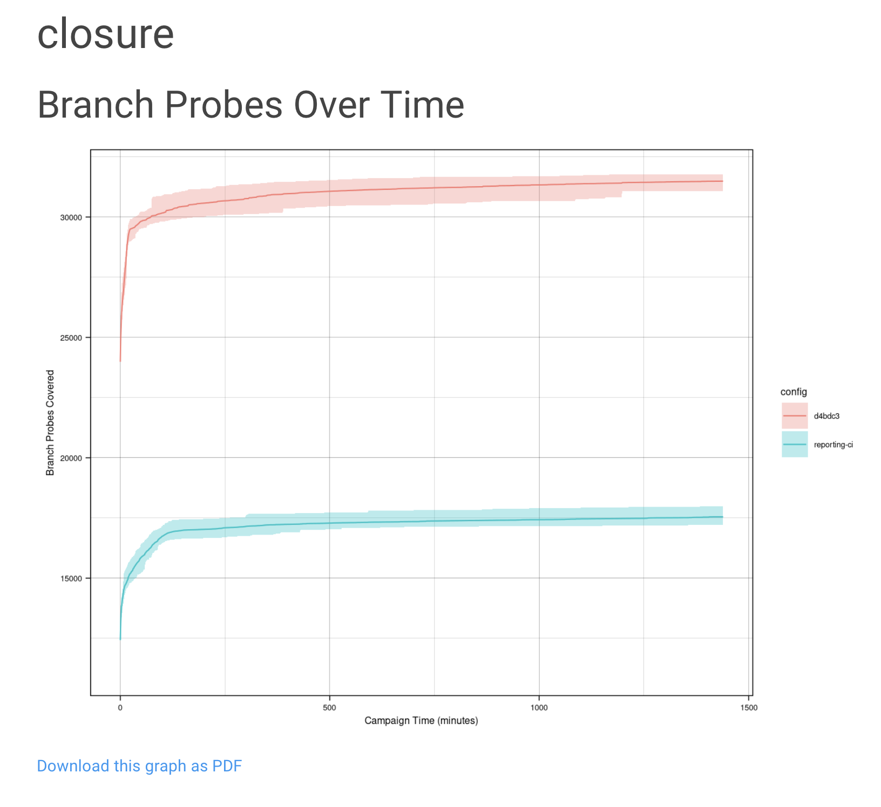
CI pipelines can automate benchmarking
On Demand: Run 24 hour performance test on 5 benchmarks, repeating each test 20 times (100 concurrent jobs)
https://github.com/neu-se/CONFETTI/actions
Notes:
Automating this kind of performance testing lets us get feedback much faster than if we had to do it manually. It also allows us to have a centralized repository of those results, so that we can track performance over time.
Here is an example of one of the graphs that get output from the report.
“branch probes over time” is one of the key performance indicators that fuzzers like this one are evaluated on. Since all of the data is centrally stored, it is easy to automate reports like this that compare the performance on the current commit to, say, another branch. This graph shows in red the current commit, and in blue, the main development branch.

Slide 20
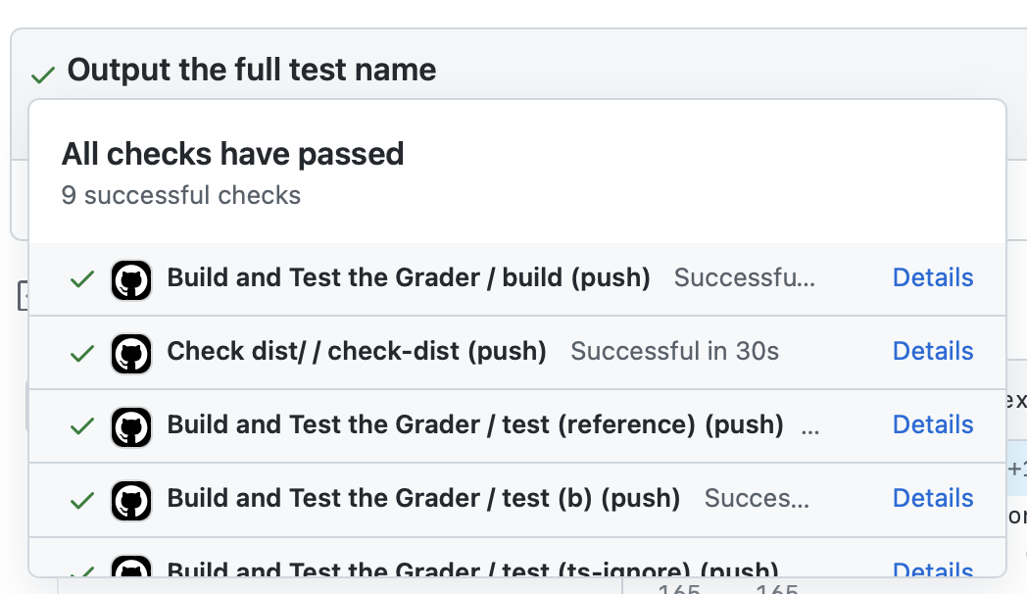
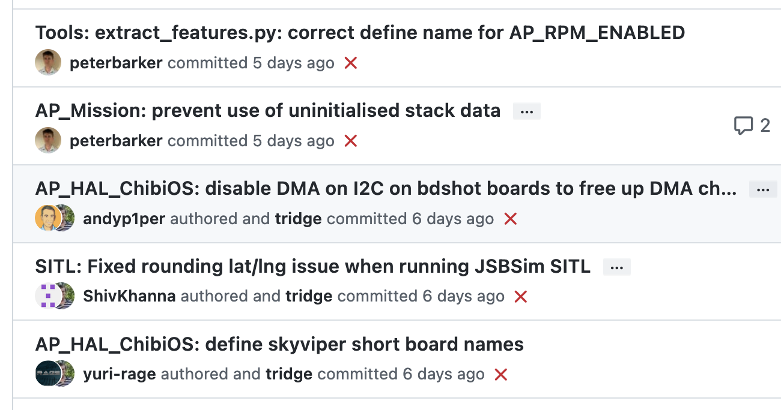
Attributes of effective CI processes
Policies:
Do not allow builds to remain broken for a long time
CI should run for every change
CI should not completely replace pre-commit testing
Infrastructure:
CI should be fast, providing feedback within minutes or hours
CI should be repeatable (deterministic)
Notes:
<read slide, some notes below:
When builds are persistently broken (failing on each change), as in the screenshot on the bottom right, developers start to ignore the outcomes.
Run on every change for the reason we just saw – reduces debugging effort
Still do pre-commit testing locally (before CI). Think about the difference between running `npm test` for IP2, vs submitting to autograder. Why would you do tests locally? -> even faster feedback
- Repeatable is important because you want to be able to reproduce same result again and again when debugging. The alternative is maybe called “flaky” and means that your CI pipeline fails due to reasons besides introducing a defect in the code, more on next slide
>

Slide 21
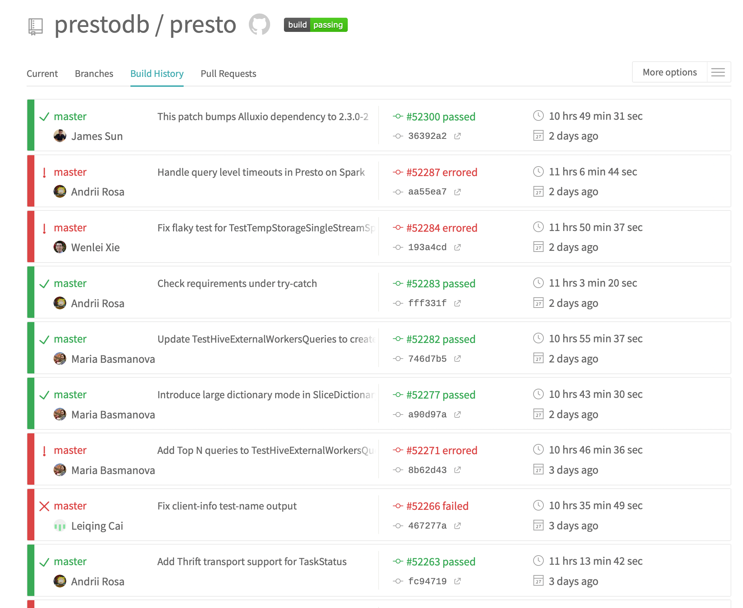
Effective CI processes are run often enough to reduce debugging effort
Failed CI runs indicate a bug was introduced, and caught in that run
More changes per-CI run require more manual debugging effort to assign blame
A single change per-CI run pinpoints the culprit
Notes:
<read slide. Consider the difference between integrating 100 commits and finding a bug vs integrating 2 commits and finding a bug. It will be much easier to figure out what introduced the bug when you only have those 2 commits!>

Slide 22
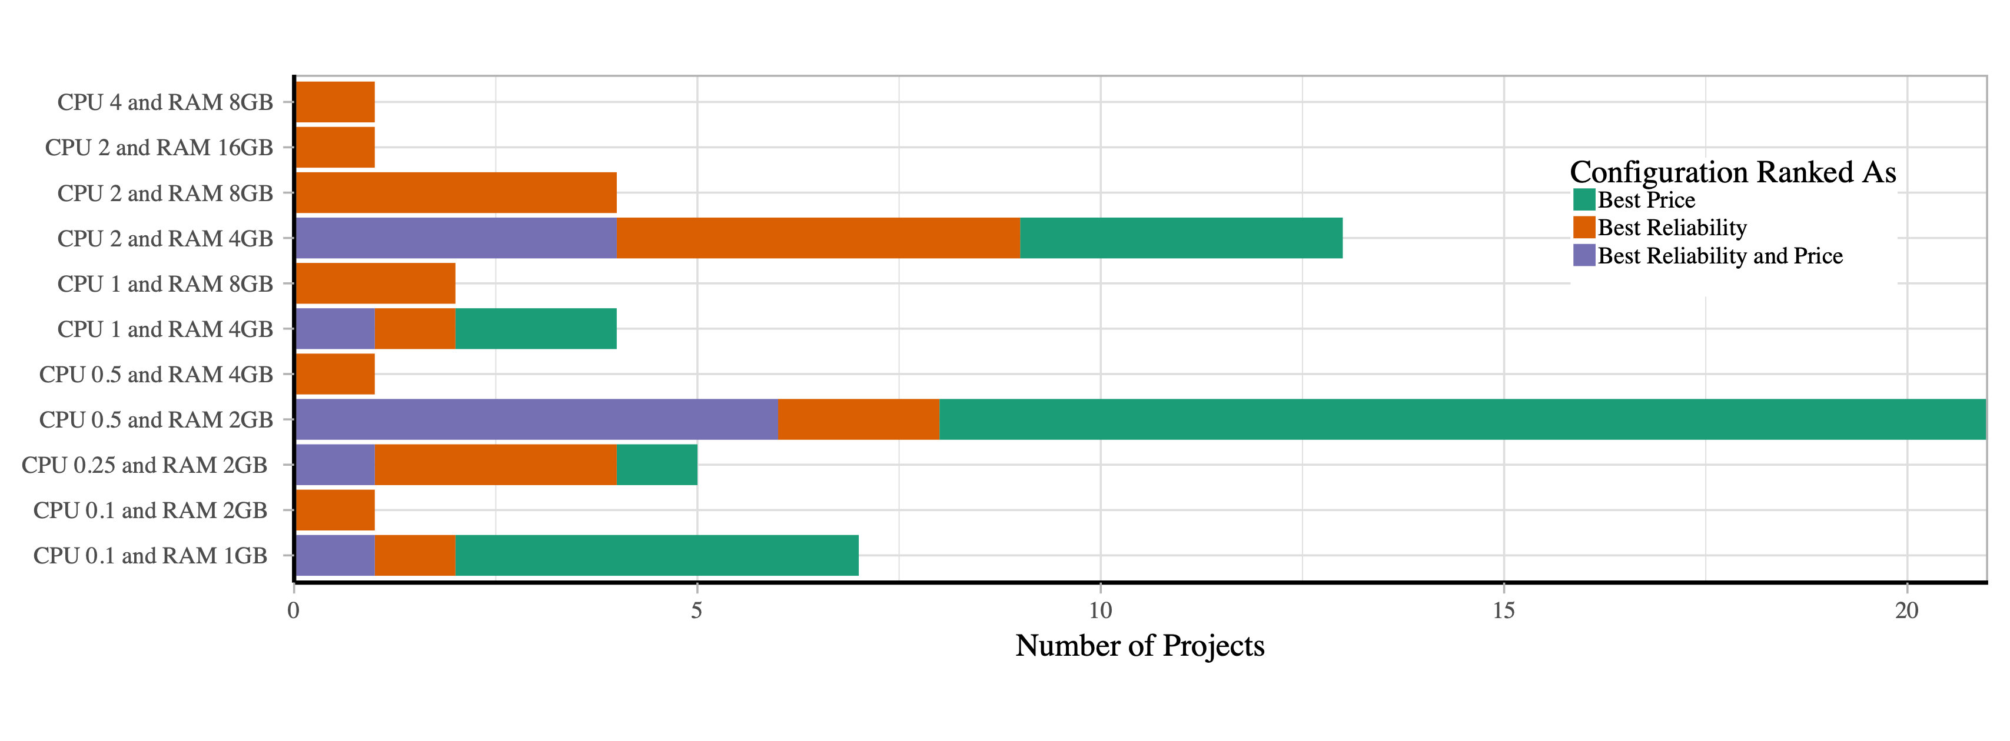
Effective CI processes allocate enough resources to mitigate flaky tests
Flaky tests might be dependent on timing (failing due to timeouts)
Running tests without enough CPU/RAM can result in increased flaky failure rates and unreliable builds
“The Effects of Computational Resources on Flaky Tests”, Silva et al
Notes:
<read slide>
The figure shows an experiment where the authors studied 30 open source projects’ CI workflows, running them 300 times each in 11 different resource configurations offered by popular cloud providers like AWS. The figure shows that some configurations that were cheaper to run (green bar) often were NOT the most reliable conifgurations – those cheaper configurations resulted in more flaky test failures.

Slide 23
Challenges and Solutions for Repeatable Builds
Which commands to run to produce an executable? (build systems)
How to link third-party libraries? (dependency managers)
How to specify system-level software requirements? (containers)
How to specify infrastructure requirements? (Infrastructure as code)
Notes:
There are four main challenges (and solutions) to repeatable CI builds. <read slide>
We’ll talk briefly about build systems, dependency managers and infrastructure as code. You’ll remember containers from our last lecture, on cloud deployment technologies.

Slide 24
Build Systems Orchestrate Software Engineering Tasks
“Orchestrate” -> Execute in the right order, ideally with concurrency, example tasks:
Installing dependencies
Compiling the code
Running static analysis
Generating documentation
Running tests
Creating artifacts for customers
Deploying Code
Example build systems: xMake, ant, maven, gradle, npm…
In most modern languages, the build system itself also serves as the dependency manager
Notes:
<read slide>
In most modern languages, the build system itself also serves as the dependency manager (e.g. Maven). Other tools focus more on providing dependency management (e.g. npm), and do not directly support the same kind of modular workflows as more powerful build systems (e.g. “grunt” is a build tool for NodeJS)

Slide 25
Dependency Managers Organize External Dependencies
Addresses this problem: “Before you compile this code, install commons-lang from the Apache website”
Declare a dependency using coordinates (unique ID of a package plus version)
Packages are archived in common repositories; fetched/linked by dependency manager
Dependency managers handle transitive dependencies 🐉
Examples: Maven, NPM, pip, cargo, apt
Notes:
<read slide>
There are dragons in “transitive dependencies” but that is the subject for another lecture that we would probably need to call “dependency hell”

Slide 26
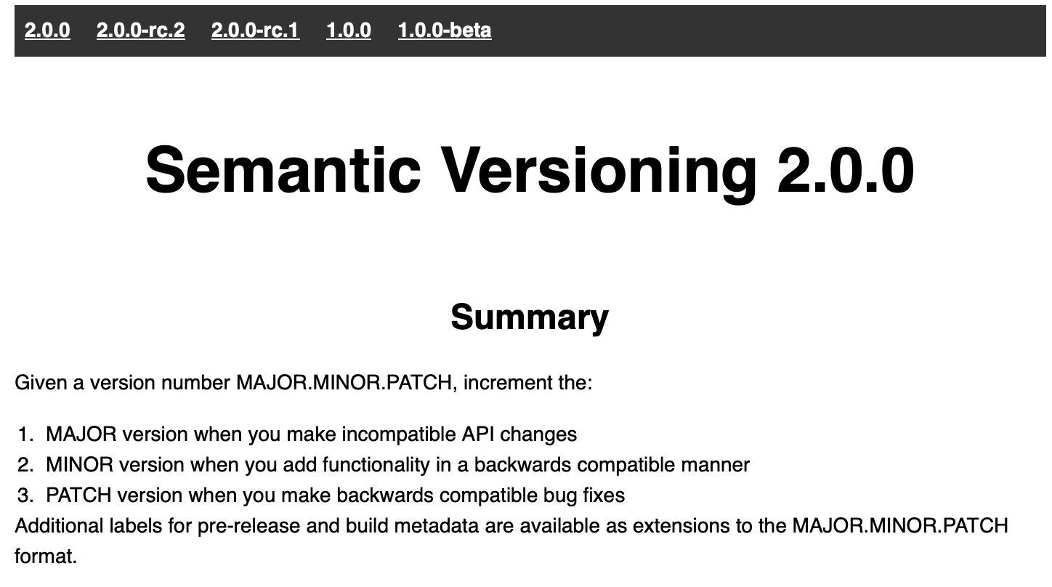
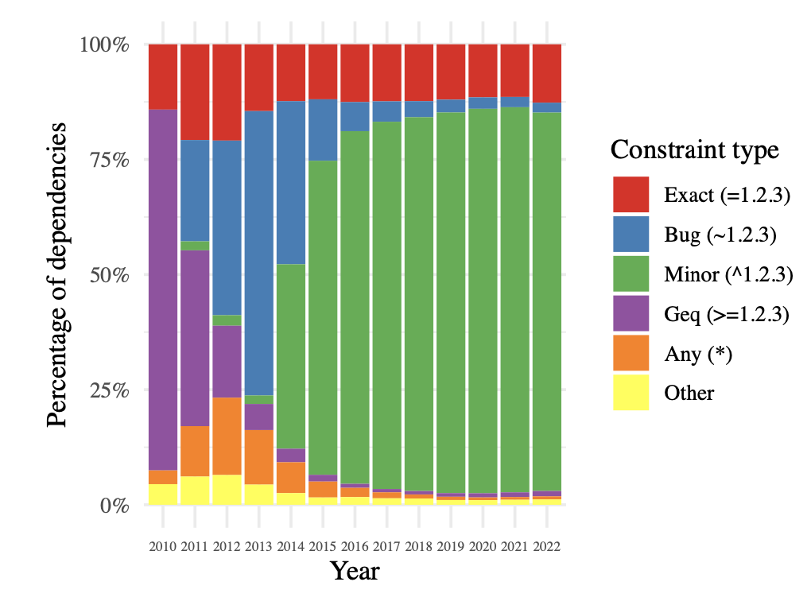
Specify and Depend on Package Versions with Care
Semantic Versioning is often expected:
Library maintainers expected to indicate breaking changes with version numbers
Dependency consumers can specify constraints on versions (e.g. accept 2.0.x)
Distribution of dependencies of all packages in NPM over time (2023, Pinckney et al)
Notes:
Semantic versioning is a generally-agreed-upon mechanism for creating and maintaining version numbers. The reason for this standard is to make it easier for library maintainers (publishing new code) to tell their consumers when breaking changes are expected.
The summary of semantic versioning is shown in the screenshot to the right. With semantic versioning (“semver”), you specify a version number as MAJOR.MINOR.PATCH. Incrementing the major number indicates that you are definitely making incompatible API changes. Incrementing the minor version indicates that there is new functionality from the prior version, but should be backwards-compatible. Incrementing the patch version indicates that you are making a backwards-compatible bug fix
Consumers of dependencies (e.g. your project that uses NPM to install dependencies) can specify constraints on dependency versions to, for example, allow for the dependency manager to automatically upgrade to a new patch version, new minor version, new major version, or to require a specific version.
The stacked bar charts on the left show the distribution of all dependencies of all packages in the NPM dependency ecosystem by-year. While at first, the typical approach was to allow changes to major versions to be applied automatically (purple, greater-or-equal constraint), over time this quickly shifted to allowing for bug (”patch”) and minor version increments. Of course, this only works if developers RELEASING packages follow these rules, and don’t introduce breaking changes in minor or patch updates!

Slide 27
Continuous Integration Service Models
Self-hosted/managed on-premises or in cloud
Jenkins
Fully cloud managed
GitHub Actions, CircleCI, Travis, many more…
Billing model: pay per-build-minute running on SaaS infrastructure
“Self-hosted runners” run builds on your own infrastructure, usually “free”
Notes:
As with many other software infrastructure components, you could configure, deploy and maintain your own CI infrastructure (that runs your CI workflow), or use a vendor’s CI service, provided in a “software-as-a-service” model.
An example of the oldest/most commonly used self-hosted open-source CI solution is “Jenkins”. There are also vendors who will run this as a service for you, if you would want that.
In the past decade, there has also been a rise in the popularity of SaaS-style CI services, like GitHub Actions ,Circle CI, Travis, and others. These services typically bill per-minute that builds run for. GitHub Actions supports a hybrid model, where GitHub hosts the whole system for triggering CI runs and collecting their output, and you bring your own “runner” that runs CI jobs. This approach lets you use your own specialized infrastructure (e.g. GPUs that you bought for some ML project), and if you do so, you can avoid paying the per-minute fee to use the vendor’s infrastructure.

Slide 28
13.2 Continuous Delivery

Slide 29
Continuous Delivery
“Faster is safer”: Key values of continuous delivery
Release frequently, in small batches
Maintain key performance indicators to evaluate the impact of updates
Phase roll-outs
Evaluate business impact of new features
Notes:
Thanks to the automated software integration pipeline that we’ve built, we can now work on closing the last feedback loop: by delivering our updates frequently, we can observe the impact of each update in relative isolation. We can be agile - releasing frequently, in small batches of updates. Thanks to automation from our CI + infrastructure system, we should be able to release with relatively low human overhead. We can maintain performance indicators like crashes, or latency and work on improving them. We can roll-out these changes to just a few users before shipping to everyone, and use this data to help determine if we should do that roll-out or not. We can even use this approach to evaluate whether newly designed features are used by users as our product designers intended - for instance, if we are implementing improvements to the usability of a commenting system, we might measure whether there are more comments made using the new feature or not. There are a few tricks that we can use to make this all work (and not make our software worse).

Slide 30
Continuous Delivery is about deciding which new features to deliver, and when
You have a large system with many engineers working on new features (and bug fixes ☺)
When a new feature or fix is ready, how do you roll it out to your users?

Slide 31
A continuous-delivery process is also a software pipeline
Automate this centrally, provide a central record of results
Develop
Build
Test
Deploy
Monitor
0…………….
Code Review
Style Check
Integration Test
End-to-end Test
KPIs
0…………….
Compile
Load Test
Unit Test
Prepare Deployment
Notes:
So, the core to continuous integration is to centrally and automatically execute these development processes, regularly.
With CI, we continuously assemble and test changes to our codebase. By performing these integrations quickly and frequently, we can get faster feedback, and hence, “shift left” - allowing bugs to be detected sooner. There’s an enormous difference in how long it takes to debug something if you detect the bug immediately after writing the code versus even, say, the next day - let alone after several weeks.
CI processes are software pipelines. “Pipeline” systems are good for building systems that have a specific order of operations, with dependencies between some steps. CI workflows follow this pattern: some steps depend on others (can’t test until you build), but many steps might be possible in parallel (run many different kinds of tests concurrently)
Consider our “social network application”, where we are changing code that builds a newsfeed, and other developers are changing other parts of the code? What concrete steps do you think that we should include in the build/test CI? Keep in mind that these might be things that you would otherwise do manually, but now have decided to automate.
<Examples, in case they don’t come up: Run unit tests, run integration tests, run international localization tests, validate that it still works with some infrastructure deployment, do regression testing, accessibility testing, check/gate on various quality metrics like coverage, security audit, code review>

Slide 32
Continuous Delivery does not mean Immediate Delivery
Even if you are deploying every day (“continuously”), you still have some latency
A new feature I develop today won't be released today
But, a new feature I develop today can begin the release pipeline today (minimizes risk)
Release Engineer: gatekeeper who decides when something is ready to go out, oversees the actual deployment process
Notes:
(read slide). Important bit is that there is latency to get to production – start dogfooding right away, but not release to public

Slide 33
Ways to mitigate deployment risks
Use a realistic staging environment
Use post-deployment monitoring
Use split deployments
Use tools to automate deployment tasks

Slide 34

Build a staging environment to qualify features for delivery
Developer Environments
Beta/Dogfooding
User Requests
Testing Environment
Staging Environment
Production Environment
Revisions are “promoted” towards production
Q/A takes place in each stage (including production!)
Notes:
Once a project is configured with IaC, it is relatively easy to have *multiple* operating clusters running an application.
This is a crucial step for enabling continuous delivery, where it is necessary to have some non-production deployments for, e.g. internal users/dogfooding.
These different deployment environments create a “deployment pipeline”, where code changes get “promoted” from one level of deployment to the next.
At each deployment step, there are extensive Q/A processes that help ensure confidence that the software is ready to ship.
Most continuous delivery pipelines involve at least these three phases, but in practice, there may be many staging environments, and several versions of the software deployed in production concurrently.

Slide 35
Split Deployments Mitigate Risk
Lower risk if a problem occurs in staging than in production
Or deploy to a small set of users before deploying more widely
Names:
“Eat your own dogfood”
Beta/Alpha testers: external vs internal
A/B testing: version A vs version B
"canaries“
Notes:
Continuous delivery allows the promise of having the benefits of testing with real users, while mitigating the risk of a costly failure.
Continuous delivery models rely on what are called “split deployments” – when a feature is initially deployed, it is not put in front of all users. Instead, there are multiple (“split”) deployments of the entire product. New features and changes are deployed to environment that has a smaller set of users who will be less impacted by bugs.
This way, there is an opportunity to identify any tricky integration-related flaws “that would only show up in production”, without having to risk upsetting people.
One example model of a split deployment is the “eat your own dogfood” model – you force your own employees to use this “pre-release” version of the app, knowing that they will be more tolerant of a crash than an end-user. For example, all Facebook employees get a company phone with a pre-release Facebook app installed.
Another example model is the alpha/beta model, where a focus group of users opt-in to use these pre-production environments.

Slide 36
Post-delivery monitoring mitigates risk
Consider both direct (e.g. business) metrics, and indirect (e.g. system) metrics
Hardware
Voltages, temperatures, fan speeds, component health
OS
Memory usage, swap usage, disk space, CPU load
Middleware
Memory, thread/db connection pools, connections, response time
Applications
Business transactions, conversion rate, status of 3rd party components
Notes:
A key enabling technology for continues delivery is metric monitoring. There might be a wide range of metrics that we can monitor to gain insights into the performance characteristics of our application (read slide)
<Ask student to brainstorm what “business metrics” might be for facebook>

Slide 37

Continuous Delivery Tools
Simplest tools deploy from a branch to a service (e.g. Render.com, Heroku)
More complex tools:
Auto-deploys from version control to a staging environment + promotes through release pipeline
Monitors key performance indicators to automatically take corrective actions
Example: “Spinnaker” (Open-Sourced by Netflix, c 2015)
Example CD pipeline from Spinnaker’s documentation: https://spinnaker.io/docs/concepts/#application-deployment
Notes:
Manually constructing and deploying to these multiple environments (and pushing changes through them) is time consuming and error prone.
A variety of tools exist to manage this process.
For this class, we’ll use fairly simple continuous delivery tools that will auto-deploy our code from a branch after its CI checks pass.
However, there are, of course, tools that fully automate more complex workflow, including canary deployments, rollbacks, etc.
<read slide. The figure is an example CD pipeline from spinnaker’s documentation>

Slide 38
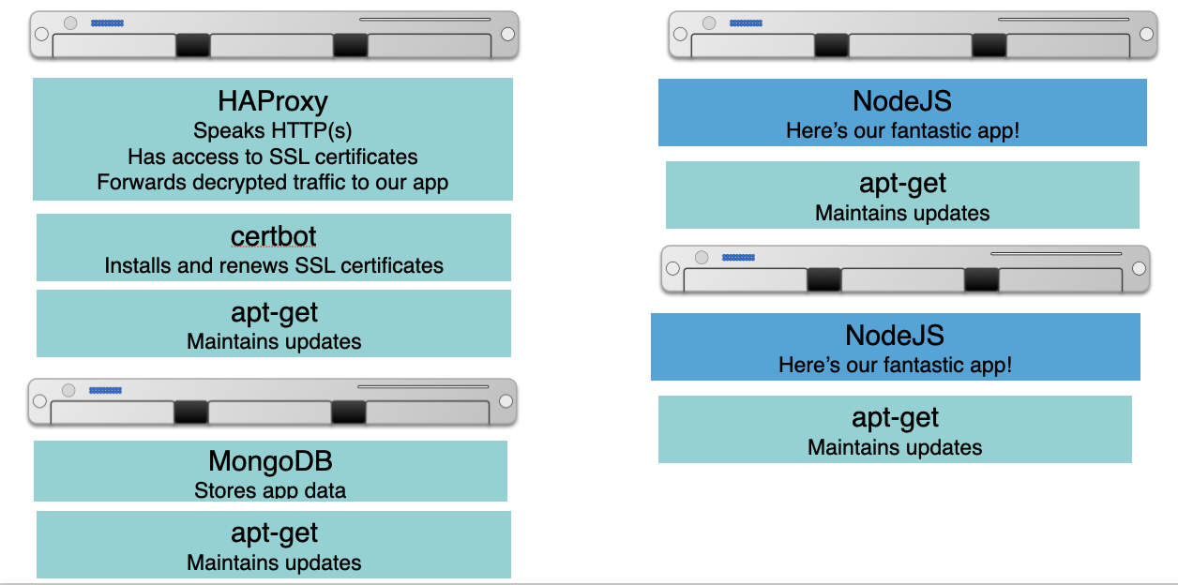
Continuous Delivery Relies on Infrastructure As Code
Provisioning servers is tedious and error prone
Deploy a VM, then ssh to it, install some packages, etc
Keeping servers up-to-date is also a struggle
Ideal:
“Give me HAProxy with some configuration file, and keep that configuration in a git repo, and when I change it, roll out an update”
“Give me some containers running my NodeJS app, and when I update my app, roll it out to those containers”
“Give me a bunch of servers with MongoDB set up in a cluster”
Notes:
Regardless of what tools you use to manage a CD pipeline, it is likely that you will rely on infrastructure as code.
The diagram on the right shows the infrastructure that you might need to run a medium-sized microservices app.
There is one VM that runs an HTTP proxy, receiving traffic from the outside world, and routing that traffic to one of two app servers running our fantastic app.
There is also a VM that runs a database.
There are also some ancillary services, like each VM has a tool for maintaining updates to the packages. The VM that receives incoming HTTPs requests also might need to have some other services for retrieving and updating an SSL certificate.
Imagine needing to manually set up and maintain this infrastructure. What happens when your boss asks for a new staging environment? What happens when there is a critical security vulnerability in an underlying package and you need to make sure that each part of your infrastructure is up-to-date?
This is the ideal set of goals that infrastructure as code aims to offer, which is crucial for enabling continuous delivery. Instead of manually deploying this infrastructure, developers can programmatically define what the infrastructure should look like, and leave it up to the Infrastructure as Code service to make it happen.

Slide 39
Infrastructure as Code represents complex infrastructure in “recipes”
Goal: Create a system that, when run, can automatically bring physical or virtual machines to some configured state
These configurations can then go into version control, code review, etc
Metaphor: “Recipes” for configuring servers, organized into “cookbooks”
Engineers define “healthy” states for infrastructure, then system automatically provisions, validates, and (if needed) repairs deployed resources
“Oh, this is how they do things at Amazon” - Inspiration for Chef, c 2009
Other tools with similar aims: Puppet (c 2005), Ansible (c 2012)
Notes:
<read slide, some notes:
There are a LOT of benefits of having your infrastructure (e.g. the set of boxes on the right) in version control – can ask students to brainstorm what they are (it’s shared with everyone who might need it, changes can be reviewed through exiting code review processes, YOU CAN EASILY REVERT CHANGES BY ROLLING BACK TO OLDER COMMIT, etc)
This procedure was happening inside of large cloud companies with proprietary, home-grown systems for some time. In 2009 a consultant partnered with a former operations lead at amazon, to create an open-source product that brought these concepts to the rest of the world
Other tools have come up since then that use different languages/interfaces to specify the infrastructure, and have somewhat different feature sets. We won’t go into them in detail, but you may have heard of, for example, Puppet or Ansible
>

Slide 40
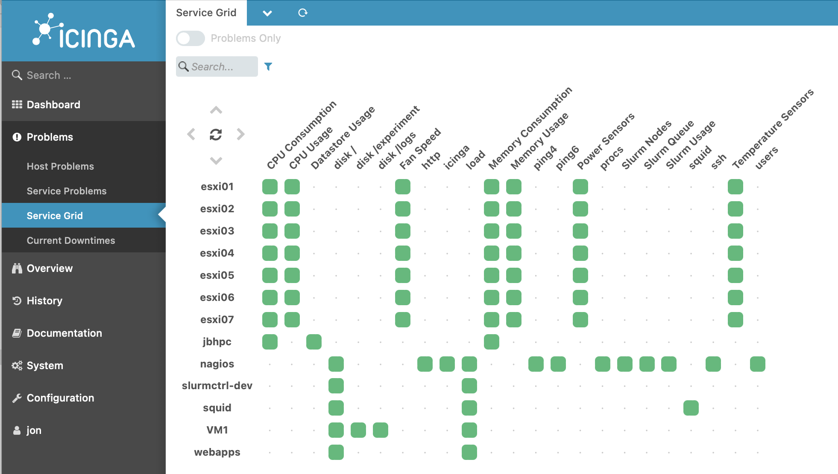
Tools for Monitoring Deployments
Nagios (c 2002): Agent-based architecture (install agent on each monitored host), extensible plugins for executing “checks” on hosts
Track system-level metrics, app-level metrics, user-level KPIs
Notes:
* Nagios is a recursive acronym: "Nagios Ain't Gonna Insist On Sainthood"[4] – "sainthood" makes reference to the original name NetSaint, which changed in response to a legal challenge by owners of a similar trademark.[ https://archive.fosdem.org/2005/index/interviews/interviews_galstad.html
Here is a screenshot of the Iciniga (good luck pronouncing it, try Aye-Singa)

Slide 41
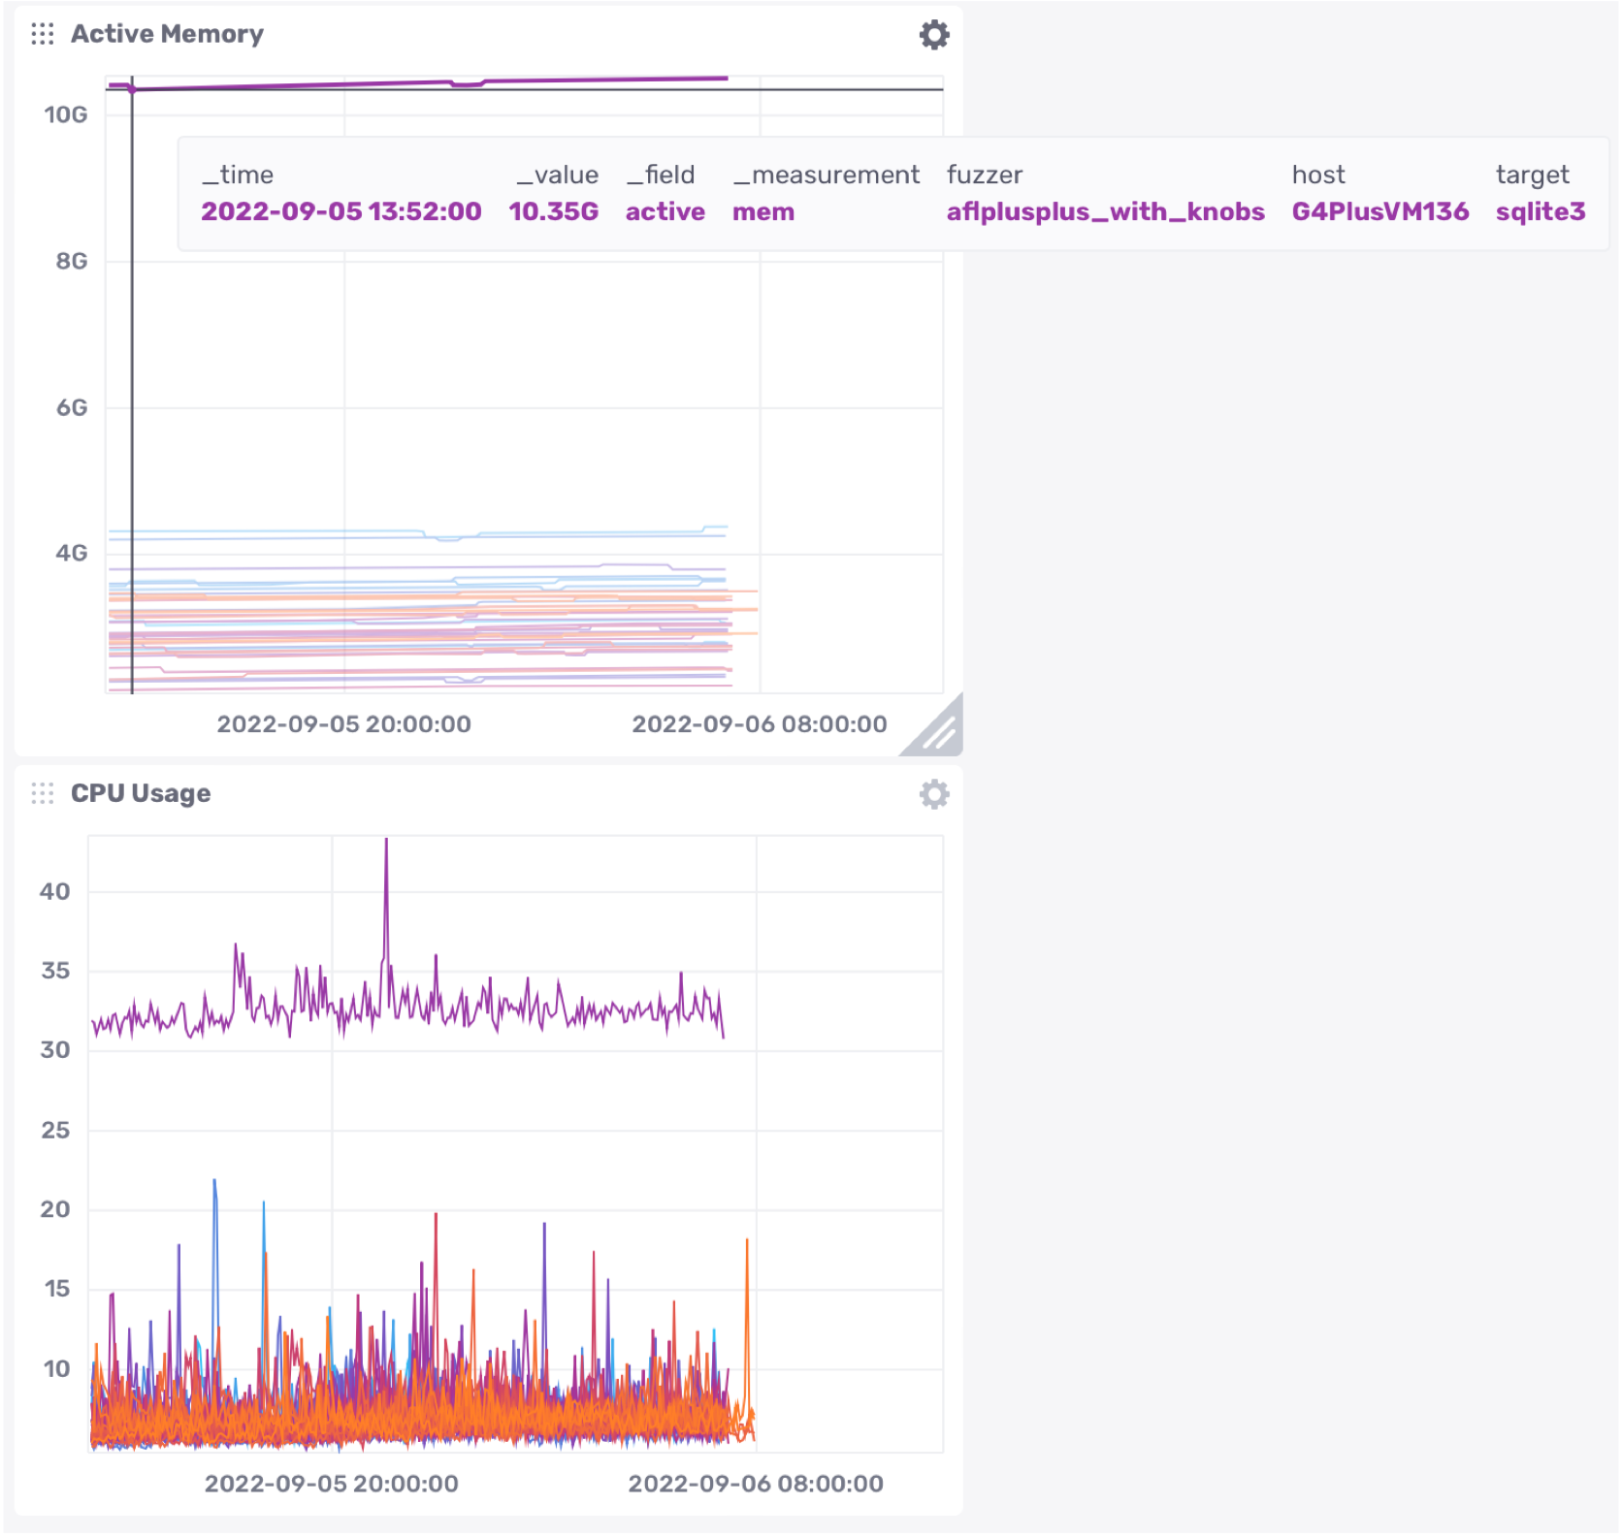
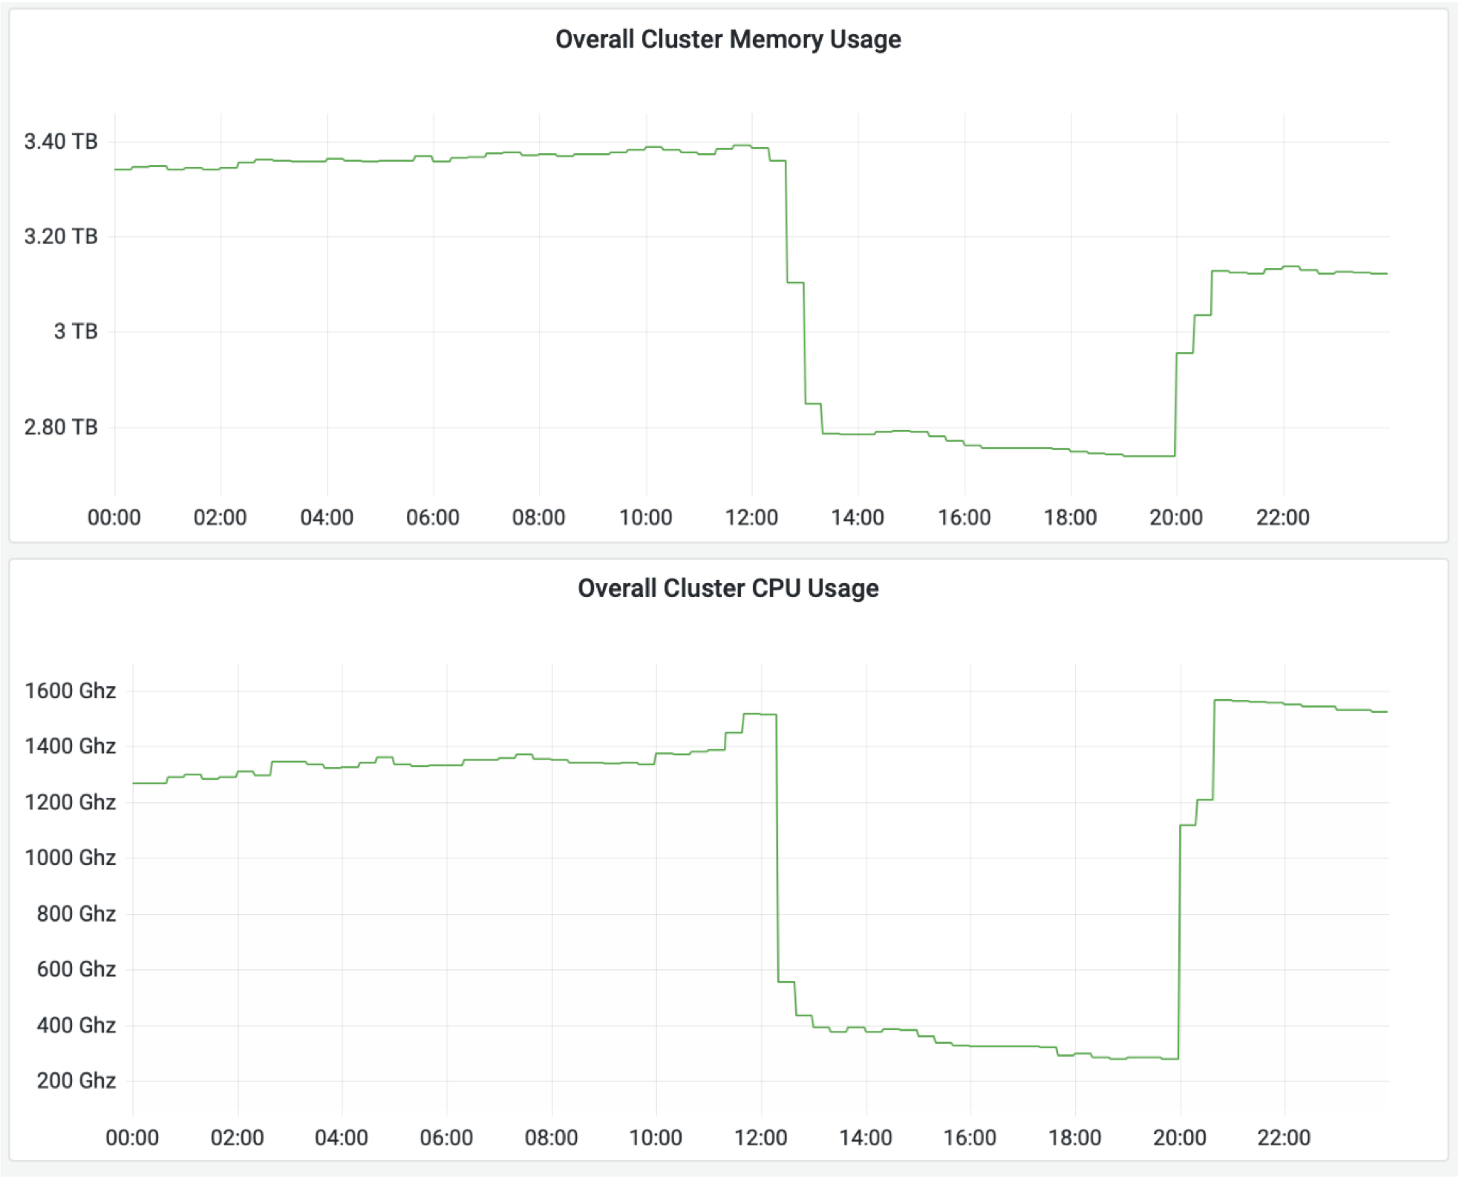
Monitoring can help identify operational issues
Grafana (AGPL, c 2014)
InfluxDB (MIT license, c 2013)
Notes:
Dashboards that aggregate multiple KPIs into one place allow a human operator to gather insights by putting in one place all of the kinds of metrics that we just saw.
Once data like this is being tracked, it’s easier to gain high-level insights by plotting it and using an interactive interface to query it. This screenshot is taken from an open-source analytics and interactive visualization product called InfluxDB.
On the left, we can see some overall hardware metrics (memory and CPU usage). On the right, we can see a drill down that shows the actual memory and CPU usage for each of many different applications that are running concurrently. We can see that there is a single outlier application in both memory and CPU usage; in the top right screenshot we can see that this application is using 10.35GB RAM, running on host “G4PlusVM136” and running target “sqlite3”. This kind of information is useful for detecting potential performance regressions before they cause more significant problems.

Slide 42
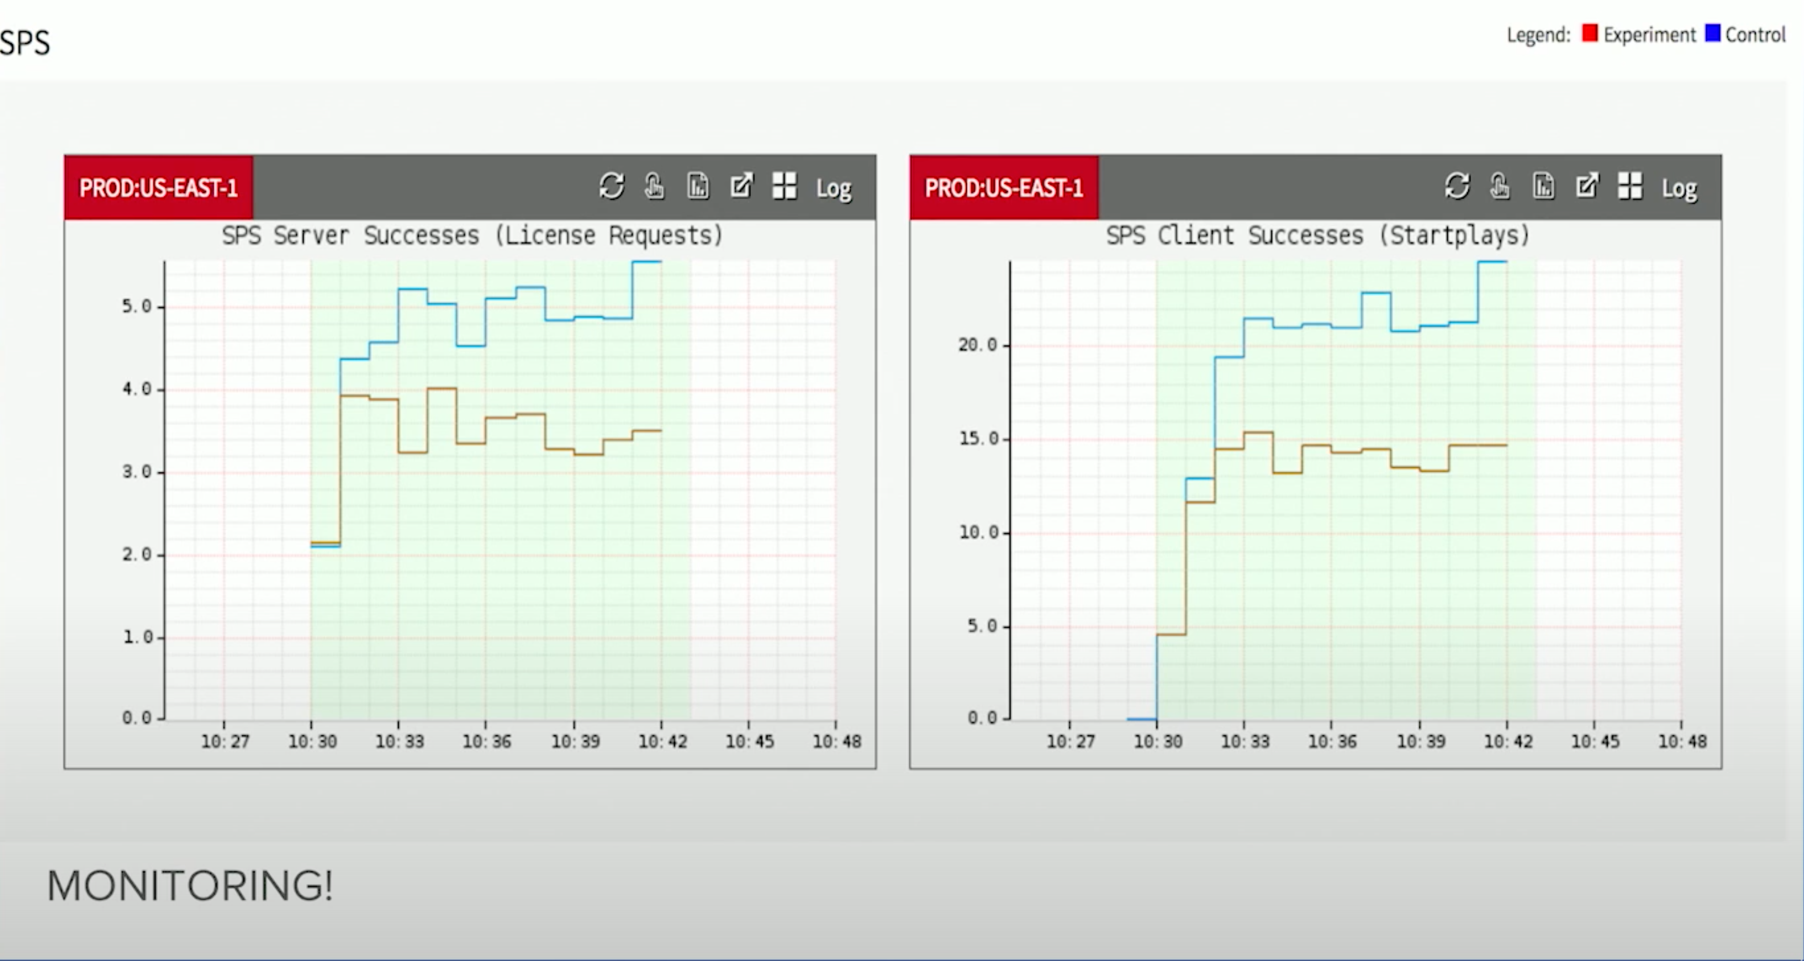
Continuous Delivery Tools Can Take Automated Actions
Example: Automated roll-back of updates at Netflix based on "streams-per-second" (SPS)
https://www.youtube.com/watch?v=qyzymLlj9ag
Notes:
In a real production scenario, we probably want to automate even more of a response than simply sending a notification.
Here is an example of application-level monitoring in practice, from Netflix. These monitoring graphs plot SPS, which is Netflix’s key business metric: “Stream starts per second” - can a user actually watch what they want to watch.
Graph shows a comparison between a “control” group (running old version of software, blue) and an “experiment” group (running new version proposed, shown in red). If SPS deviates between control and expected, auto-rollback occurs within seconds; no manual intervention is necessary.

Slide 43
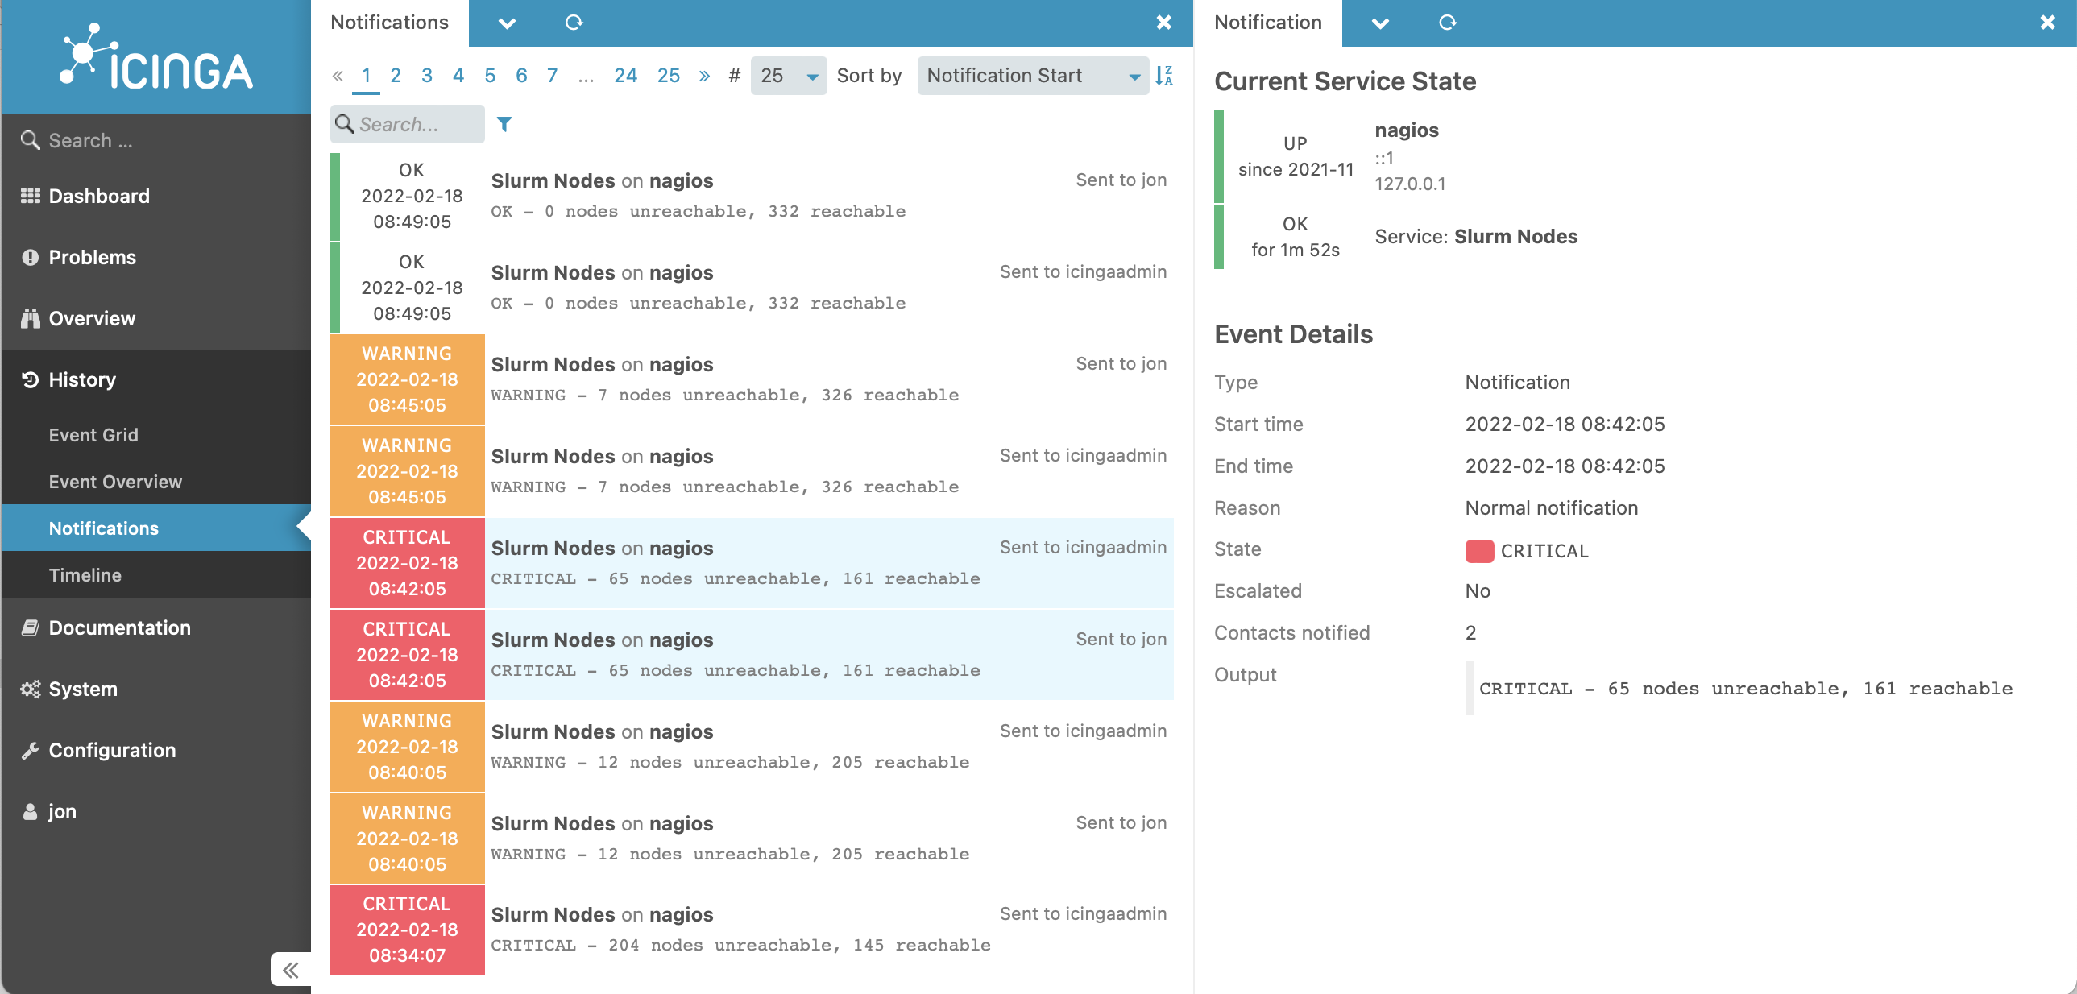
Monitoring Services Can Take Automated Actions
Notes:
Once we are monitoring these KPIs, it’s also possible to set up automated processes that take actions when certain events happen. Here’s a screenshot of another view of Icinga. One of the key kinds of actions that Icinga is designed to take is to simply track problems and run a series of escalating notifications to ensure that they get noticed and resolved. In this screenshot, you can see the various times that the “slurm nodes” application service degraded and then eventually entirely failed on Feb 18. Each entry shows a notification that was sent.
People pay money for PagerDuty.

Slide 44

From Monitoring to Observability
Understanding what is going on inside of our deployed systems by visualizing internal metrics
Example dashboard by DataDog:
https://www.datadoghq.com/blog/gke-dashboards-integration-improvements/
Notes:
One of the newest buzzwords around continuous delivery and monitoring is “observability” – the idea that an engineer who is responsible for operating the application can visualize what is happening inside of it, and use that input to improve the application. This screenshot shows an example of a dashboard provided by a popular SaaS observability tool called “Datadog”.
<note: many students likely have had experience using datadog on co-ops, it’s a good topic to ask about>

Slide 45
New Tools allow Observability inside of Apps, Too
Screenshot: https://www.akitasoftware.com/blog-posts/plug-and-play-endpoint-views-for-metrics-errors
Notes:
In addition to visualizing system-level metrics (like number of containers deployed, their CPU usage and memory usage, etc), it can also be extremely useful to track metrics from within apps – like latency, error rates, etc. to discover problems before they show up at a higher level (e.g. notice that request are taking longer to complete before

Slide 46

Beware of Metrics
McNamara Fallacy
Measure whatever can be easily measured
Disregard that which cannot be measured easily
Presume that which cannot be measured easily is not important
Presume that which cannot be measured easily does not exist
Notes:
When talking about quantitative metrics, it’s extremely important to consider how rigidly we follow them. Setting KPIs for monitoring is a very good idea, but not all important metrics can be easily measured quantitatively.
Robert McNamara was secdef in the 60’s, had previously been an executive at Ford where he made quantitative metrics for each phase of production and ruthlessly optimized to improve efficiency and production. Applied similar strategy to secdef… “Things you can count, you ought to count - loss of life is one” - so, based lots of strategy on body counts. Body count is one thing, but not the whole picture. After war ended in interviews, generals commented that body counts were misguided way to measure progress. Compare to: using LoC to track progress on a project… how do you even know how many lines there should be, and is it good to have a lot? Software metrics are very tricky because it it is hard to quantify everything.

Slide 47
How should we allocate our testing resources?
How much unit testing should be required?
When should we do code reviews?
How often should we do integration tests?
Different organizations may make different choices

Slide 48
Continuous Delivery works with or without TDD
Test driven development (“Test first”)
Write and maintain tests per-feature (manual! hard!)
Unit tests help locate bugs (at unit level)
Integration/system tests also needed to locate interaction-related faults
Test suites can become larger and larger
Continuous delivery work with smaller test suites
Write and maintain high-level observability metrics
Deploy features one-at-a-time, look for canaries in metrics
Write fewer integration/system tests
Notes:
<read slide>
In many startups (including Facebook), writing large test suites is not ideal. Think about the original critiques of waterfall vs agile: waterfall had “lots of wasted products” – e.g. when the wrong feature is developed. Agile can still have wasted products, too – what if you build and test a feature that you don’t end up needing? Continuous delivery allows you to reduce the number of tests that you write, because you rely on internal deployments and alpha and beta testers for feedback. This allows for faster time to market.
However, as we have seen in the case studies in this lecture, to really get the *safety* of continuous delivery, you need a real process that:
Deploys features one-at-a-time. If multiple features are deployed together, you won’t be able to tell which feature causes a defect that you observe in production
Monitors key indicators, allowing you to determine quickly if a change introduces a bug
Automatically reverts changes that introduce bugs, reducing impact
<Ask students: Do you think facebook uses TDD? Why/why not? The answer is that they don’t. Kent Beck joined facebook and tried to make people use TDD and he was literally told he was going to be fired within his first few weeks if he didn’t spend more time writing features and less time writing tests>

Slide 49
CI at scale: Google Test Automation Platform - TAP (2020)
Massive continuous build of entire Google codebase
in a dedicated data center
50,000 unique changes per-day, 4 billion test cases per-day
Engineers submit unit tests along with their changes
Block merge if they fail
If they pass, change is put in the codebase.
visible to entire company!
average wait time to this point: 11 minutes
Then (asynchronously) run all affected integration tests
If any fail, change is sent back to a human on the submitter's team (the “build cop”) who must act immediately to roll-back or fix.
“Software Engineering at Google: Lessons Learned from Programming Over Time,” Wright, Winters and Manshreck, 2020 (O’Reilly), pp. 494-497
Notes:
Google Test Automation Platform

Slide 50
Facebook: "Move fast and break things"
de-prioritize unit tests
Emphasis on getting features to users quickly
Strategy: push many small changes to fractions of the user base. ("split deployments")

Slide 51
Deployment Example: Facebook.com
Pre-2016
Developers working in their own branch
When feature is ready, push as 1 change to master branch
~1 week of development
~1 week of development
master branch
3 days
4 days
All changes that survived stabilizing
Stabilize
Release Branch
Weekly
All changes from week
that are ready for release
release branch
production
Your change doesn’t go out unless you’re there that day at that time to support it!
3x Daily
“When in doubt back out”
Notes:
https://engineering.fb.com/2017/08/31/web/rapid-release-at-massive-scale/
Here is an example of a large-scale continuous deployment pipeline.
This chart shows the overall process that was used before 2016 to deploy Facebook.com. (read diagram; important bits: dev branches get merged into master, then once a week all changes from the past week are pulled into a release branch. For 3 days they “stabilize” the release branch – find changes that are causing very bad behavior and back them out. Then for the last 4 days of the week, every change that survived that stabilization gets individually pushed to production batched so that this happens 3x/day. Important to do small deploys so that you can isolate bad changes)
What was bad about this? Didn’t scale. How many changes going out? 500-700 PER DAY. By 2016 might be pushing 10k diffs per week. ENORMOUS effort to co-ordinate (between the “your change doesn’t go out unless you’re there to support it” and “when in doubt back it out” – both very manual)
(From the blog post):
For many years, we pushed the Facebook front end three times a day using a simple master and release branch strategy. Engineers would request cherry-picks — changes to the code that had passed a series of automated tests — to pull from the master branch into one of the daily pushes from the release branch. In general, we saw between 500 and 700 cherry-picks per day. Once a week, we’d cut a new release branch that picked up any changes that were not cherry-picked during the week.
By 2016, we saw that the branch/cherry-pick model was reaching its limit. We were ingesting more than 1,000 diffs a day to the master branch, and the weekly push was sometimes as many as 10,000 diffs. The amount of manual effort needed to coordinate and deliver such a large release every week was not sustainable.

Slide 52
Facebook used to have an elaborate system of branches
dev branches got merged into master,
then once a week all changes from the past week were pulled into a release branch (often 10,000 changes per week)
For 3 days they “stabilized” the release branch – find changes that are causing very bad behavior and back them out. (manual process!!)
Then for the last 4 days of the week, every change that survived that stabilization got individually pushed to production batched so that this happens 3x/day.
Important to do small deploys so that you could isolate bad changes.
Notes:
https://engineering.fb.com/2017/08/31/web/rapid-release-at-massive-scale/
Here is an example of a large-scale continuous deployment pipeline.
This chart shows the overall process that was used before 2016 to deploy Facebook.com. (read diagram; important bits: dev branches get merged into master, then once a week all changes from the past week are pulled into a release branch. For 3 days they “stabilize” the release branch – find changes that are causing very bad behavior and back them out. Then for the last 4 days of the week, every change that survived that stabilization gets individually pushed to production batched so that this happens 3x/day. Important to do small deploys so that you can isolate bad changes)
What was bad about this? Didn’t scale. How many changes going out? 500-700 PER DAY. By 2016 might be pushing 10k diffs per week. ENORMOUS effort to co-ordinate (between the “your change doesn’t go out unless you’re there to support it” and “when in doubt back it out” – both very manual)
(From the blog post):
For many years, we pushed the Facebook front end three times a day using a simple master and release branch strategy. Engineers would request cherry-picks — changes to the code that had passed a series of automated tests — to pull from the master branch into one of the daily pushes from the release branch. In general, we saw between 500 and 700 cherry-picks per day. Once a week, we’d cut a new release branch that picked up any changes that were not cherry-picked during the week.
By 2016, we saw that the branch/cherry-pick model was reaching its limit. We were ingesting more than 1,000 diffs a day to the master branch, and the weekly push was sometimes as many as 10,000 diffs. The amount of manual effort needed to coordinate and deliver such a large release every week was not sustainable.

Slide 53
Deployment Example
“Our main goal was to make sure that the new system made people’s experience better — or at least, didn’t make it worse. After a year of planning and development, over the course of three days we enabled 100% of our production web servers to run code deployed directly from master”
Chuck Rossi, Director Software Infrastructure & Release Engineering @ Facebook
“Rapid release at massive scale” https://engineering.fb.com/2017/08/31/web/rapid-release-at-massive-scale/
Notes:
So, Facebook re-architected their release process. (pause to read quote)
The “people” whose experiences were improved were:
- Devs trying to get changes deployed (who wanted the most frictionless process)
- Build cops and release engineers who were responsible for executing the QA and overall process.

Slide 54
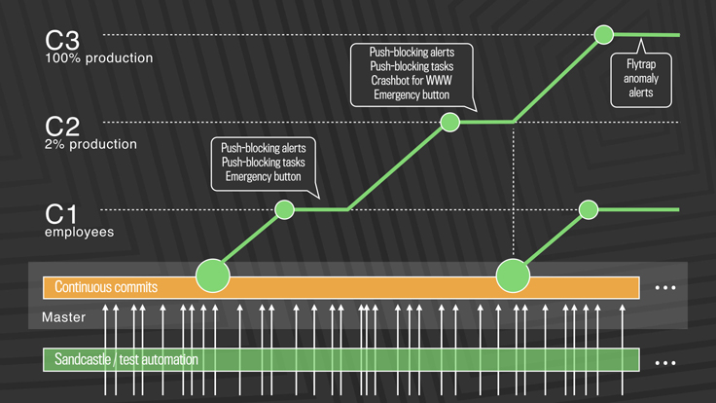
Post-2016: truly continuous releases from master branch
https://engineering.fb.com/2017/08/31/web/rapid-release-at-massive-scale/
Notes:
This approach solves the problem of scaling continuous delivery. In Facebook’s new deployment model, there is no manual cherry-picking, and there are automated processes to detect anomalies and revert changes. There are three-tiers of deployment, from C1 (dog-fooding/staging) to C2 (deployment to a small slice of production) to C3 (deployment to entirety of production workload)
The process works like this: (copied from blog post)
First, diffs that have passed a series of automated internal tests and land in master are pushed out to Facebook employees. In this stage, we get push-blocking alerts if we’ve introduced a regression, and an emergency stop button lets us keep the release from going any further. If everything is OK, we push the changes to 2 percent of production, where again we collect signal and monitor alerts, especially for edge cases that our testing or employee dogfooding may not have picked up. Finally, we roll out to 100 percent of production, where our Flytrap tool aggregates user reports and alerts us to any anomalies.
Many of the changes are initially kept behind our feature flags, which allows to roll out mobile and web code releases independently from new features, helping to lower the risk of any particular update causing a problem. If we do find a problem, we can simply switch the feature off rather than revert back to a previous version or fix forward.

Slide 55
Post-2016: Truly Continuous Releases from Master Branch (excerpts from blog post)
First, diffs that have passed a series of automated internal tests and land in master are pushed out to Facebook employees.
In this stage, get push-blocking alerts if we’ve introduced a regression, and an emergency stop button lets us keep the release from going any further.
If everything is OK, push the changes to 2 percent of production, where again we collect signal and monitor alerts, especially for edge cases that our testing or employee dogfooding may not have picked up.
Finally, roll out to 100 percent of production, where our Flytrap tool aggregates user reports and alerts us to any anomalies.
Many of the changes are initially kept behind feature flags, which allows to roll out mobile and web code releases independently from new features, helping to lower the risk of any particular update causing a problem.
If we do find a problem, simply switch the feature off rather than revert back to a previous version or fix forward.
https://engineering.fb.com/2017/08/31/web/rapid-release-at-massive-scale/
Notes:
This approach solves the problem of scaling continuous delivery. In Facebook’s new deployment model, there is no manual cherry-picking, and there are automated processes to detect anomalies and revert changes. There are three-tiers of deployment, from C1 (dog-fooding/staging) to C2 (deployment to a small slice of production) to C3 (deployment to entirety of production workload)
The process works like this: (copied from blog post)
First, diffs that have passed a series of automated internal tests and land in master are pushed out to Facebook employees. In this stage, we get push-blocking alerts if we’ve introduced a regression, and an emergency stop button lets us keep the release from going any further. If everything is OK, we push the changes to 2 percent of production, where again we collect signal and monitor alerts, especially for edge cases that our testing or employee dogfooding may not have picked up. Finally, we roll out to 100 percent of production, where our Flytrap tool aggregates user reports and alerts us to any anomalies.
Many of the changes are initially kept behind our feature flags, which allows to roll out mobile and web code releases independently from new features, helping to lower the risk of any particular update causing a problem. If we do find a problem, we can simply switch the feature off rather than revert back to a previous version or fix forward.

Slide 56
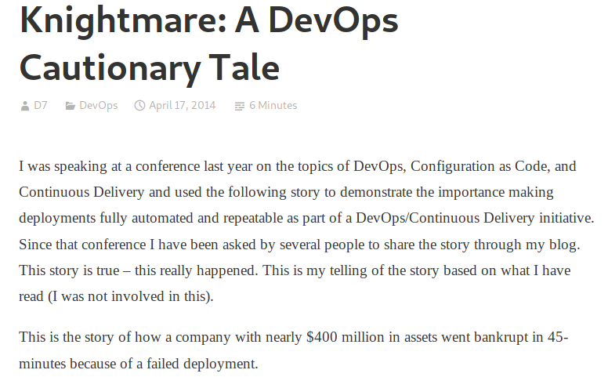
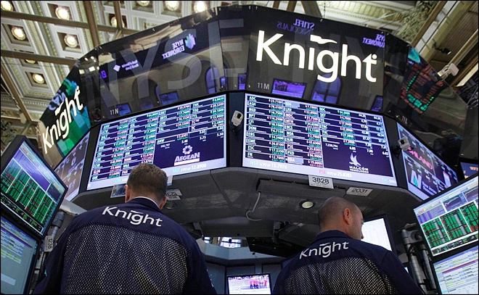
What not to do: Failed Deployment at Knight Capital
“In the week before go-live, a Knight engineer manually deployed the new RLP code in SMARS to its 8 servers. However, he made a mistake and did not copy the new code to one of the servers. Knight did not have a second engineer review the deployment, and neither was there an automated system to alert anyone to the discrepancy. “
https://www.henricodolfing.com/2019/06/project-failure-case-study-knight-capital.html
Notes:
The short of it:
Built a new trading system, created a system for testing that would attempt to drive prices up or down (at a significant loss per-transaction) in order to test system responses to market conditions
Had to manually deploy the new code to some servers…
Did not remove the testing code (“power peg”) from one of the eight
In first hour of trading the system bought $7 billion of stocks (money that Knight didn’t have)
No planned processes to monitor the deployed system or to roll back to a working one (they actually made it worse while trying to fix it, restoring the “power peg” testing code on all remaining servers - why not just shut the whole thing down?)
Goldman Sachs quite generously bailed out Knight capital, buying the $7b position for a $440m discount
Ask students to compare/contrast with the tail-strike situation, where after the second tail strike, all planes were grounded for 22 minutes while the problem was root-caused and a fix was instituted.

Slide 57
What could Knight capital have done better?
Use capture/replay testing instead of driving market conditions in a test
Avoid including “test” code in production deployments
Automate deployments
Define and monitor risk-based KPIs
Create checklists for responding to incidents
Notes:
The Knight capital story is definitely an interesting one, and perhaps now that we have discussed some strategies for continuous deployment, it is hopefully somewhat clearer how this enormous financial loss could have been prevented.
First, some comments on the testing strategy:
Why, why why why is it a good idea to write a test case that actually tries to change market conditions, when you could instead test your code using simulated/historical market conditions?
Never include testing code in production deployments: that test code for changing markets in order to test the system response to them was included in the production code!?!
Then on the deployments:
If deployment were automated, there would not be a step for an engineer to miss on one of the 8 deployments: they could always happen predictably
There was insufficient monitoring. The way that this error was detected was the NYSE had noticed that market volume was more than expected, and then traced it back to Knight. Nobody at Knight had thought to create a dashboard that monitored their volume (and perhaps more importantly, financial exposure vs assets at hand). This could have been detected *immediately* and automatically paged the relevant people (and perhaps also automatically paused the firm’s trading activities). Seems like a reasonable investment.
There were no checklists for responding to incidents, and no procedures to roll-back if needed. We’ll see that “If in doubt back it out” is the Facebook philosophy to avoid this kind of failure, but this requires a process to be in place so that it can be easily triggered

Slide 58
Review
By now, you should be able to…
Describe how continuous integration helps to catch errors sooner in the software lifecycle
Describe strategies for performing quality-assurance on software as and after it is delivered
Understand how continuous delivery can work with or without TDD (test driven development) as a quality assurance strategy

